Slide 1
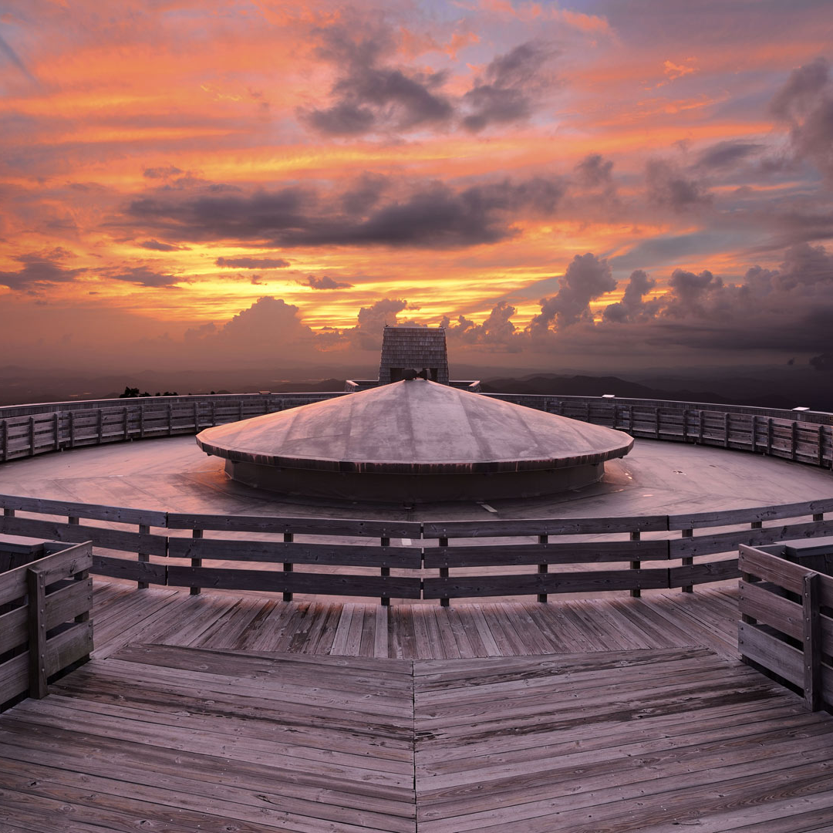
Automatic Identification of Ships on Satellite Images
BUPT & QMUL Joint Programme
Final Year Project 2019
Final Viva
Zhaoxiong Chen 陈兆雄
BUPT No.
QMUL No.
Class
Branch
2015213445
151007198
2015215121
International School - Internet of Things Engineering

Slide 2
Introduction & Background
Design & Implementation
Contents
Results & Conclusion
Further Work

Slide 3
Part 1
Introduction & Background
Part 2 Design & Implementation
Part 3 Results & Conclusion
Part 4 Further Work

Slide 4
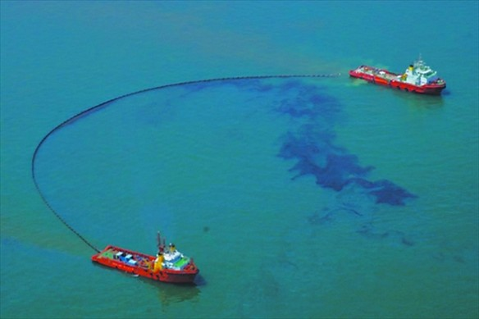
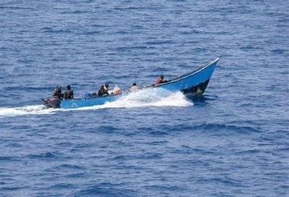
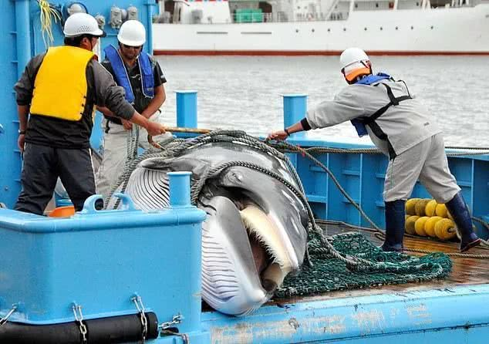
Motivation
Oil leak from tankers
Pirates
Illegal whales fishing
Environmental hazard
Illegal activities on public sea

Slide 5
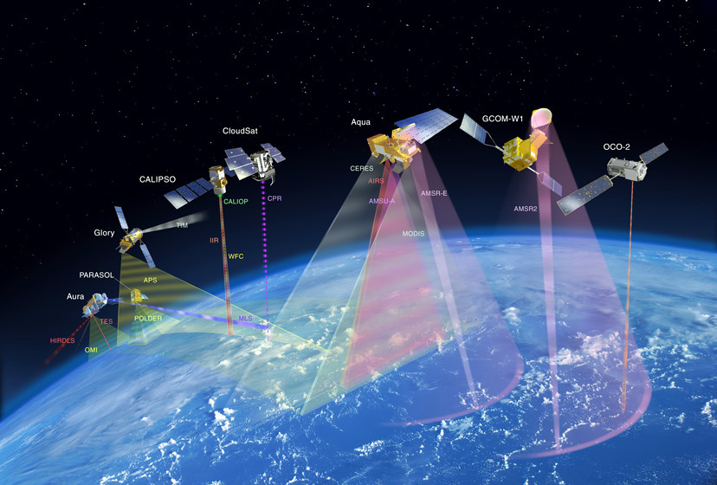

Motivation
Remote sensing
Deep learning

Slide 6
Summary
Project Aim
Project Benefits
To implement state-of-the-art data science (deep learning) approaches to correctly identify ships from satellite images.
Profit increase through
Cropping the budget on time, human resources and software development through scalable method;
Increasing the profit by improving business efficiency and helping optimize schedule;

Slide 7
Methodology
An artificial intelligence function that imitates the workings of the human brain in processing data and creating patterns for use in decision making.
Traditional
Deep Learning

Slide 8
Methodology
A technique where a model trained on one task is re-purposed on a second related task.
Transfer
Learning

Slide 9
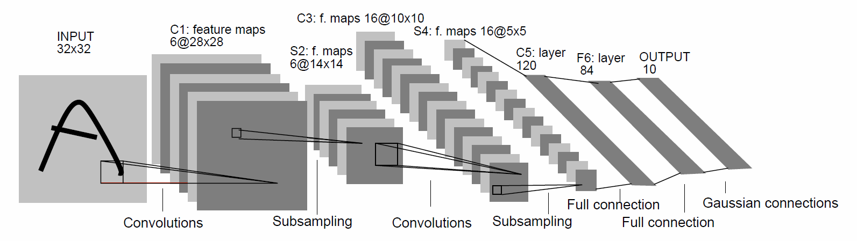
Convolutional Neural Network

Slide 10
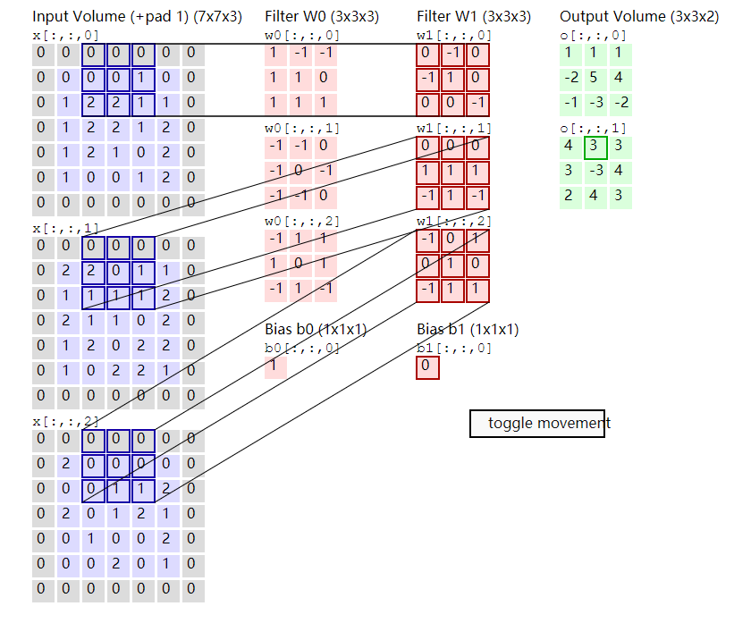


Convolutional Neural Network
Convolutional Layer
MaxPooling Layer
Fully-Connected Layer

Slide 11
Part 1
Introduction & Background
Part 2 Design & Implementation
Part 3 Results & Conclusion
Part 4 Further Work

Slide 12
Part 1 Introduction & Background
Part 2
Design & Implementation
Part 3 Results & Conclusion
Part 4 Further Work

Slide 13


System Environment
Microsoft
Windows 10 Version 1803
NVIDIA
CUDA Driver 9.0
cuDNN 7.4.1.5

Slide 14

Key Software Dependencies
Keras + TensorFlow
Matplotlib
Selected deep learning libraries.
Keras uses TensorFlow as backend.
Visualisation on:
Ship existence statistics figure;
Performance of trained models;
Prediction of ship existence possibility;
Pandas + Numpy
Scikit
Scientific data processing tools.
Dataset Analysis;
Dataset Segmentation;

Slide 15
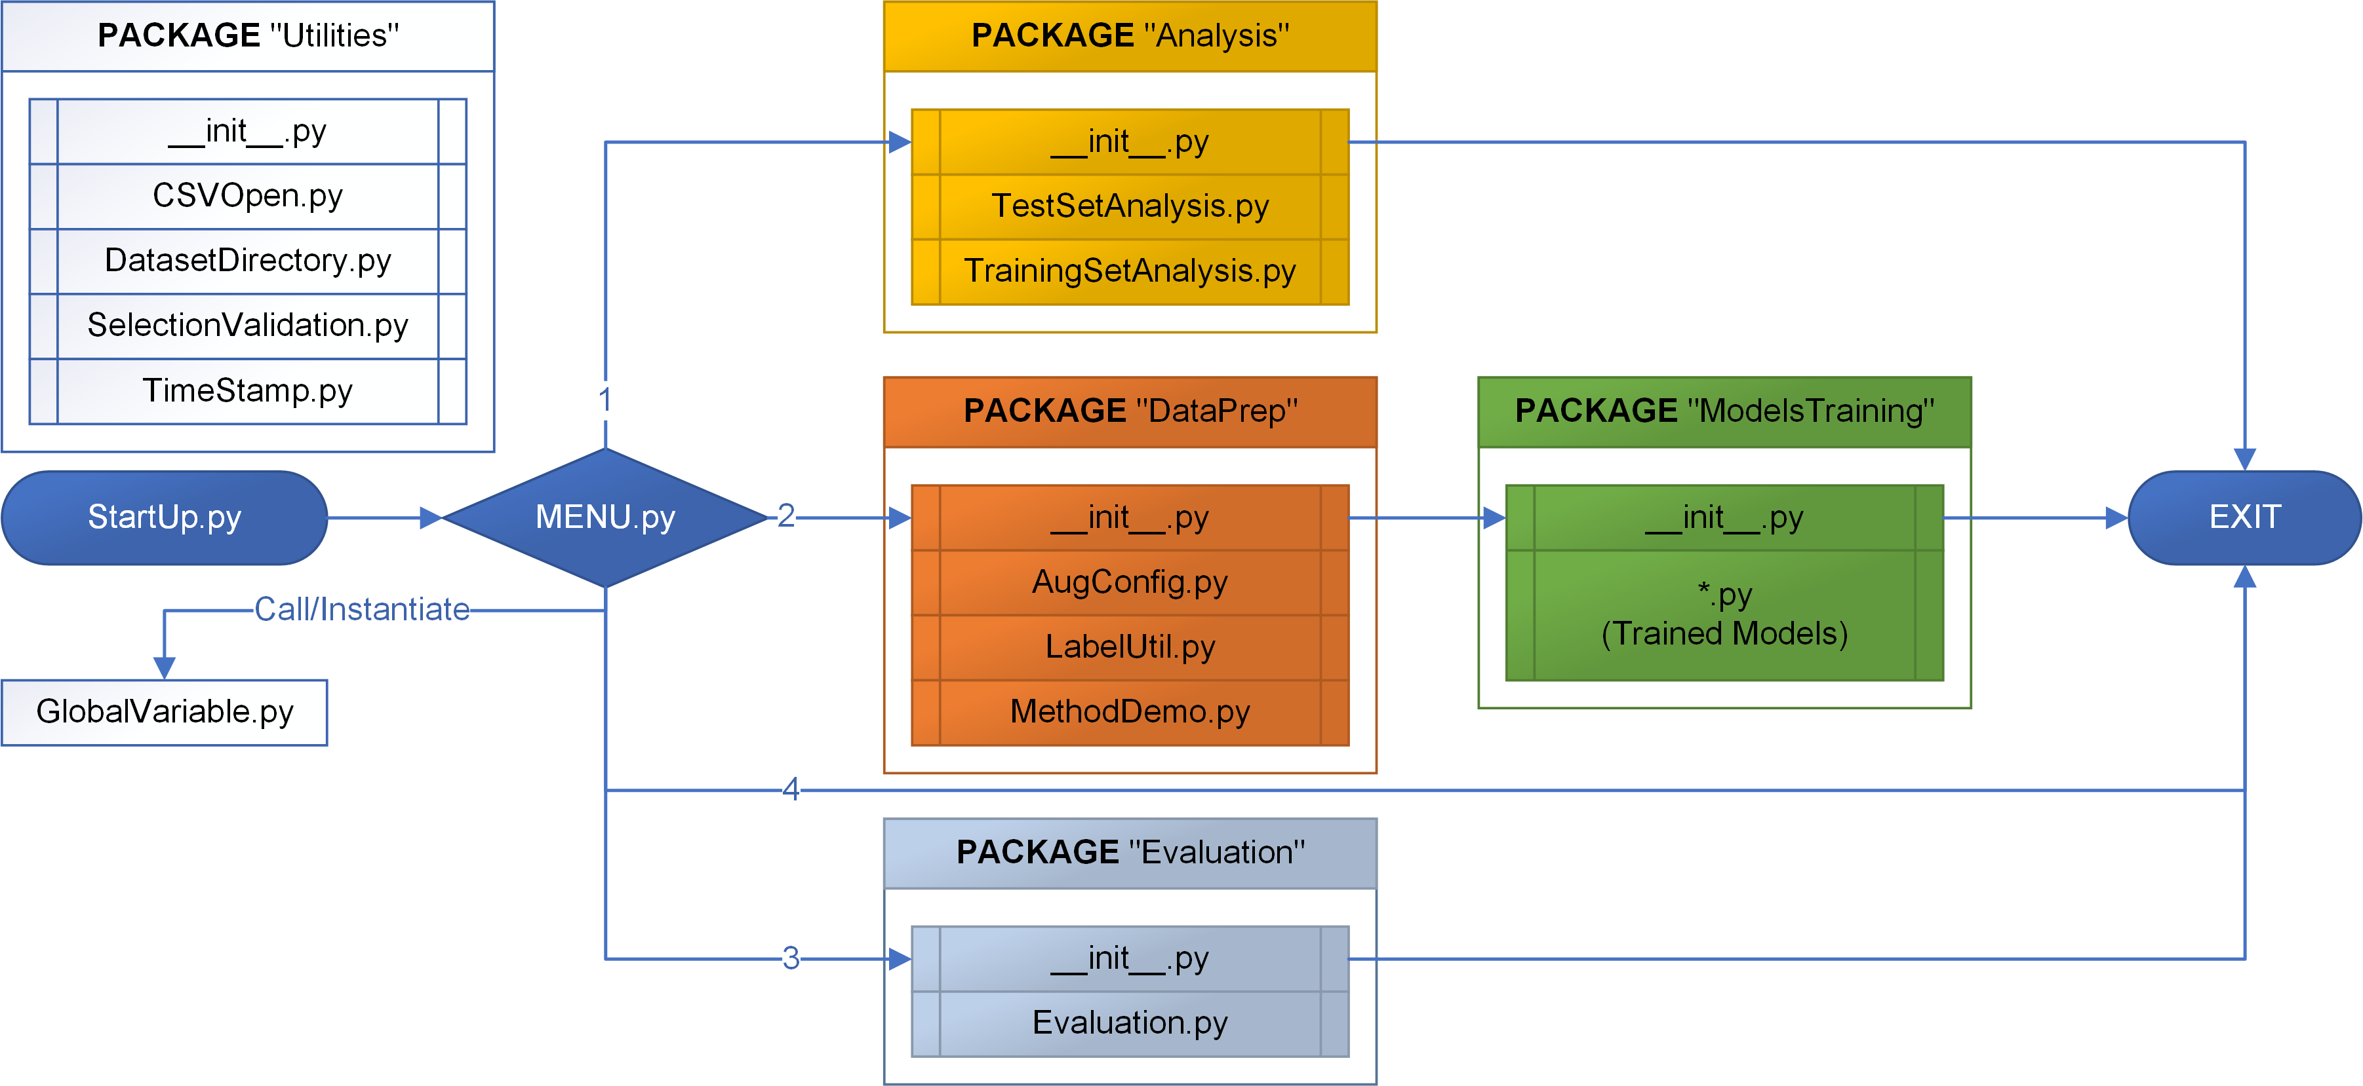
Application Structure

Slide 16
Data Set Analysis
Downloaded from kaggle.com
Provided by Airbus
192,556 images in training set
15,606 images in test set
Attribute | Description | Type of value | Value
Width | Width of image | Integer | 768
Height | Height of image | Integer | 768
#Channel | Number of channels | Integer | 3
#Pixel | Number of pixels | Integer | 1769472
MaxPixel | Maximum pixel value | Integer | Varies from 0 to 255
MinPixel | Minimum pixel value | Integer | Varies from 0 to 255
AveragePixel | Average pixel value | Integer | Varies from 0 to 255
Type | Number of bits | Unsigned Integer | 8
Extension | Type of image | String | “.jpg”
Size | Size of image (Byte) | Integer | Varies from each image
Directory | Directory of images | String | Varies from each image

Slide 17
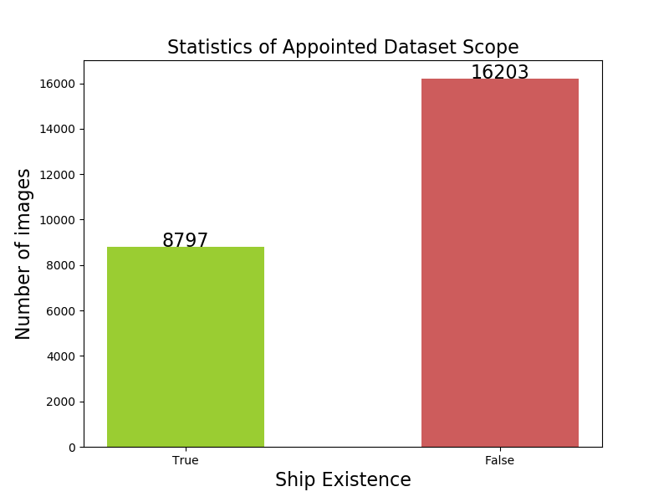


Actual Data Usage
Data Preparation
Mode “Sampled”
25,000 images random selected from training set
Segmentation ratio - training set : test set = 8 : 2

Slide 18
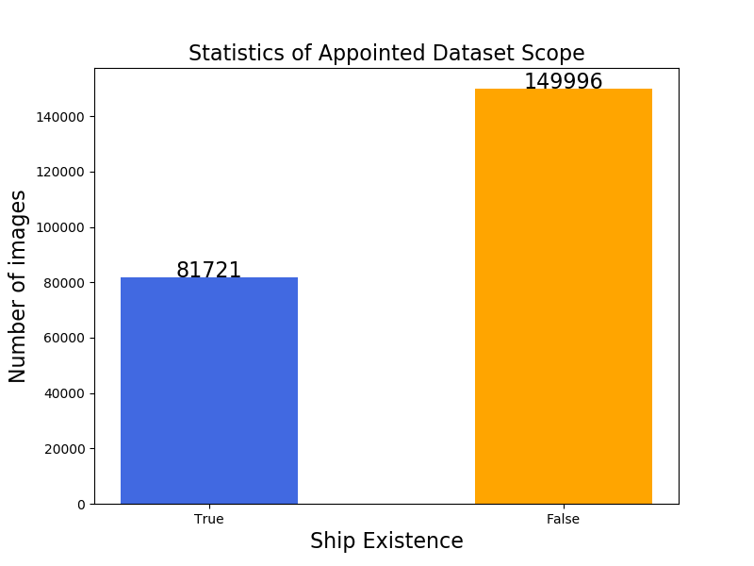


Actual Data Usage
Mode “Whole DataSet”
192,556 images in training set
Segmentation ratio - training set : test set = 8 : 2

Slide 19
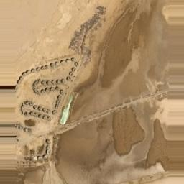
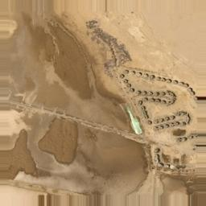
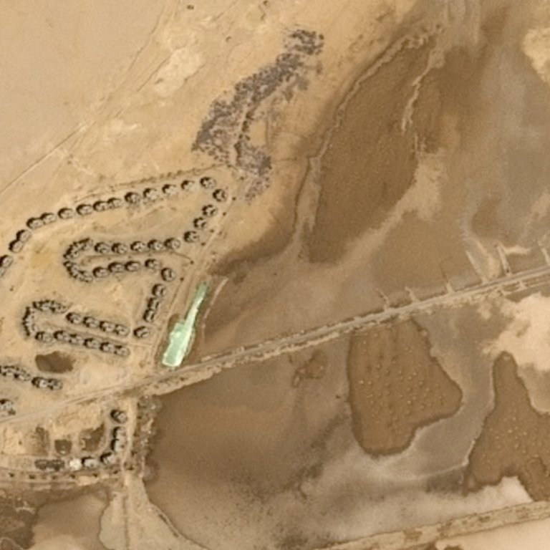
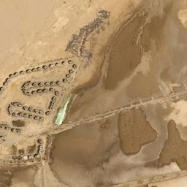
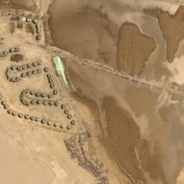
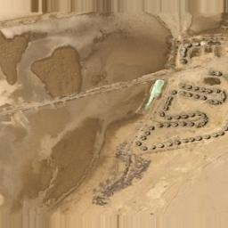
Data Augmentation Config
Mode “Sampled”
Training Set P1
256×256
HF: OFF, VF: OFF
Shear: 20%
Zoom: 20%
Training Set P3
256×256
HF: ON, VF: OFF
Shear: 20%
Zoom: 20%
Test Set
256×256
Training Set P2
256×256
HF: OFF, VF: ON
Shear: 20%
Zoom: 20%
Training Set P4
256×256
HF: ON, VF: ON
Shear: 20%
Zoom: 20%
Original
768×768

Slide 20
Data Augmentation Config
Mode “Whole DataSet”
Training Set
256×256
Test Set
256×256
Original
768×768

Slide 21
Models Training
Nutshell
4 Types
9 Models
30+ Training Times
Batch Size Setup
Epoch Setup
AlexNet
CNN
VGG
ResNet
See next slide
From 02/2019
To 04/2019
2
100
250
1000
20 times for all models

Slide 22
Models Training
Details
Name Postfix Explanation
Mod
Modified model
PT
Use pre-trained parameters
D
Dense layer modification
F
Filter size modification
KS
Kernel size & stride modification
Model Name | Training Approach | #Total Parameters | #Trainable Parameters | Name Postfix
AlexNet | Traditional | 58,285,441 | 58,285,441 | /
AlexNetMod_D | Traditional | 4,943,617 | 4,943,617 | Mod_D
AlexNetMod_D_F | Traditional | 552,673 | 552,673 | Mod_D_F
AlexNetMod_D_F_KS | Traditional | 7,597,921 | 7,597,921 | Mod_D_F_KS
CNNBenchmark | Traditional | 3,706,049 | 3,706,049 | /
ResNet50PT | Transfer | 158,857,089 | 135,269,377 | PT
VGG16Mod_D_F | Traditional | 6,180,945 | 6,180,945 | Mod_D_F
VGG16PT | Transfer | 33,601,345 | 18,886,657 | PT
VGG16 | Traditional | 134,264,641 | 134,264,641 | /

Slide 23
Evaluation
Python built-in pack.
matplotlib-pyplot
Read History
Plot Figures
matplotlib-pyplot
Graphviz & pydot
Prediction Result
Architecture Visualisation

Slide 24
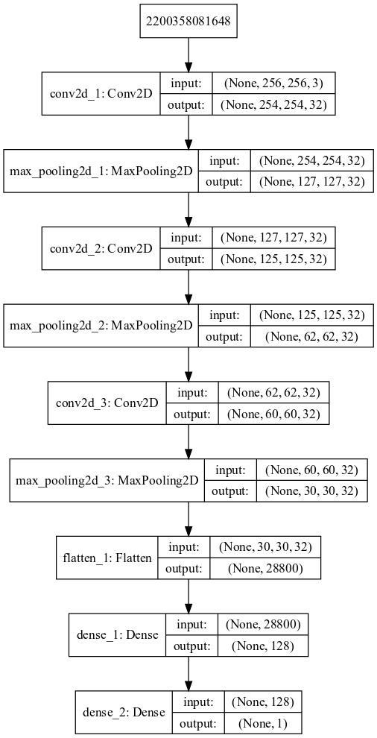
Architecture Visualisation
Graphviz + Pydot
Keras “plot_model” function
Architecture of “CNNBenchmark”
For more, please refer to the report.

Slide 25
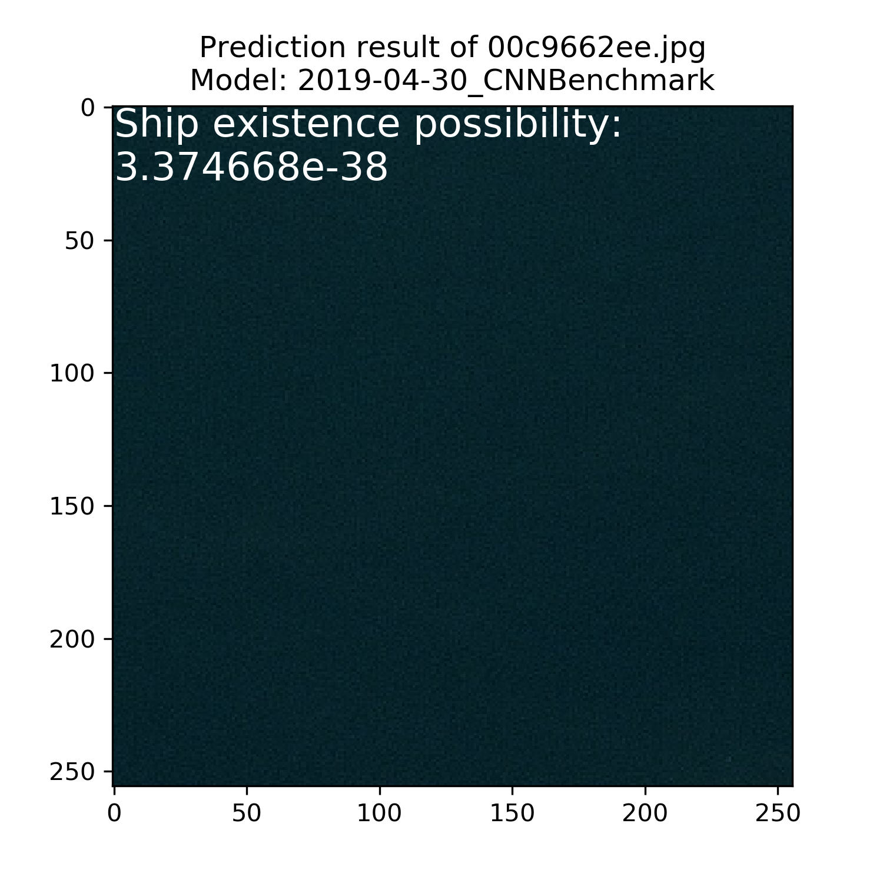
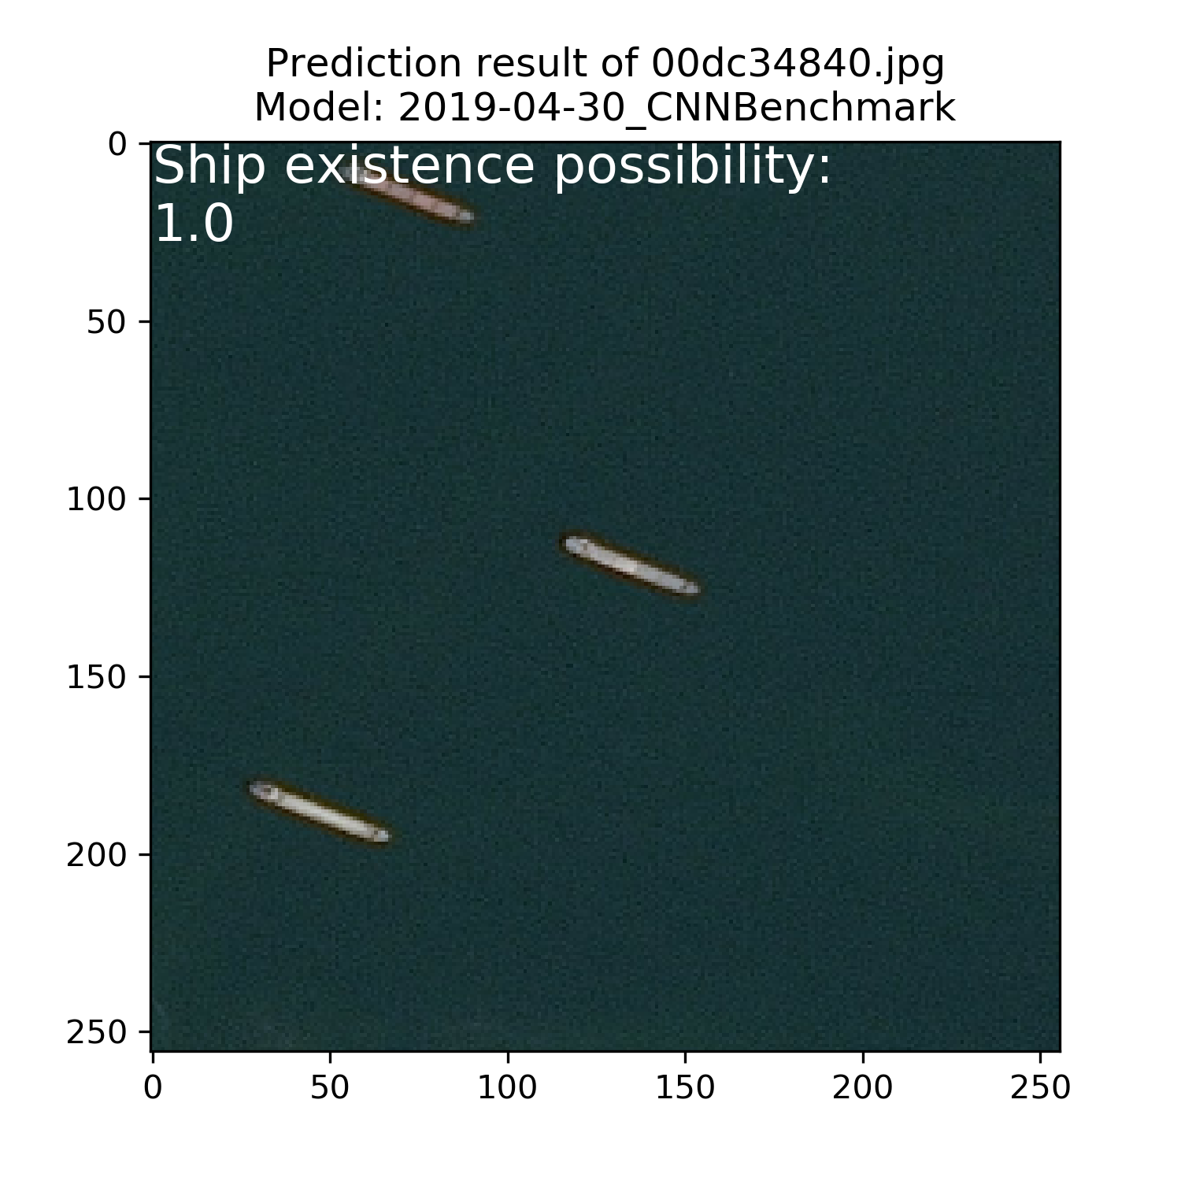
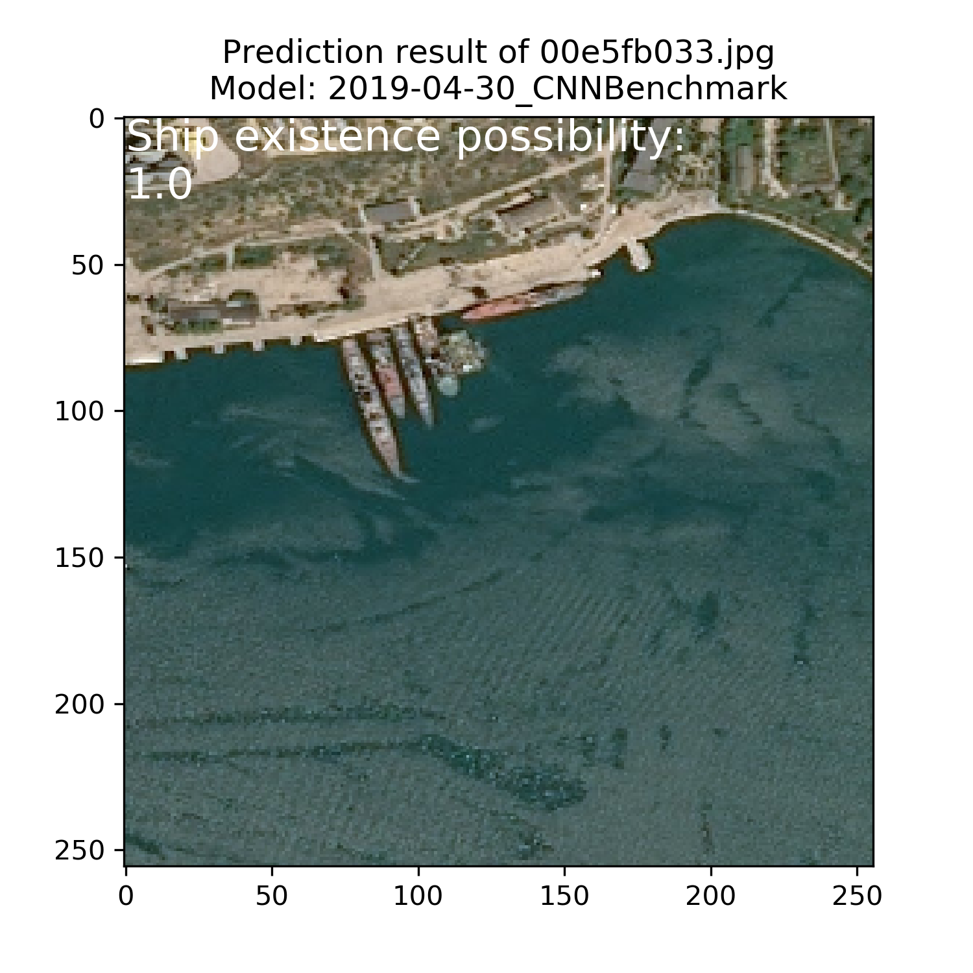
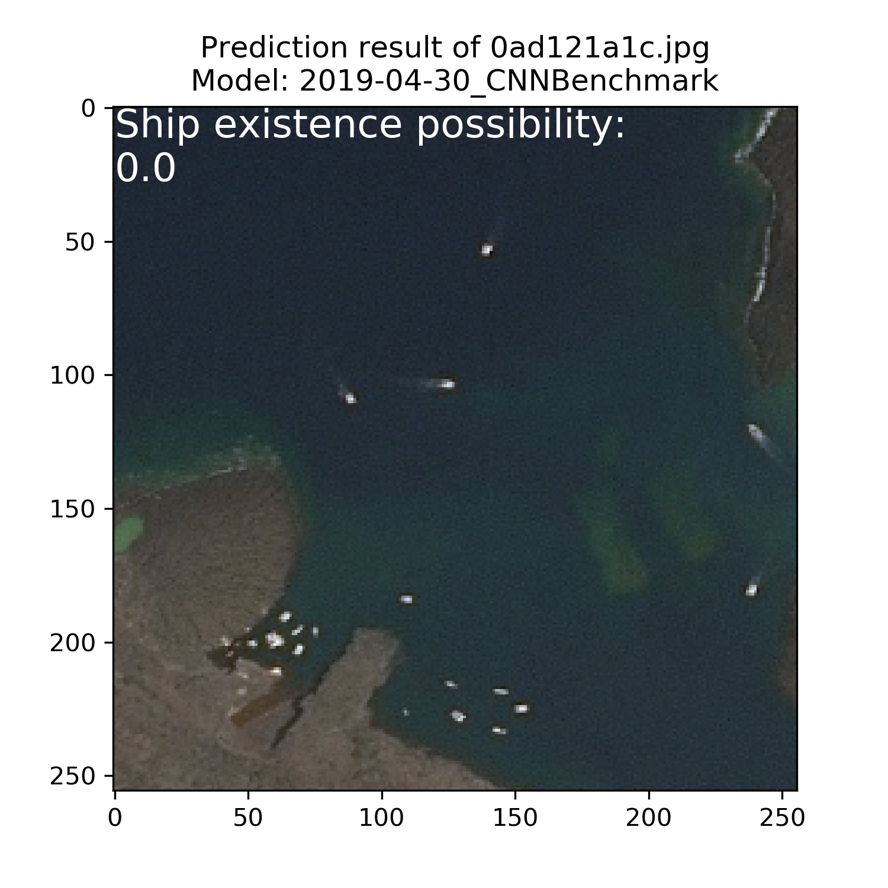
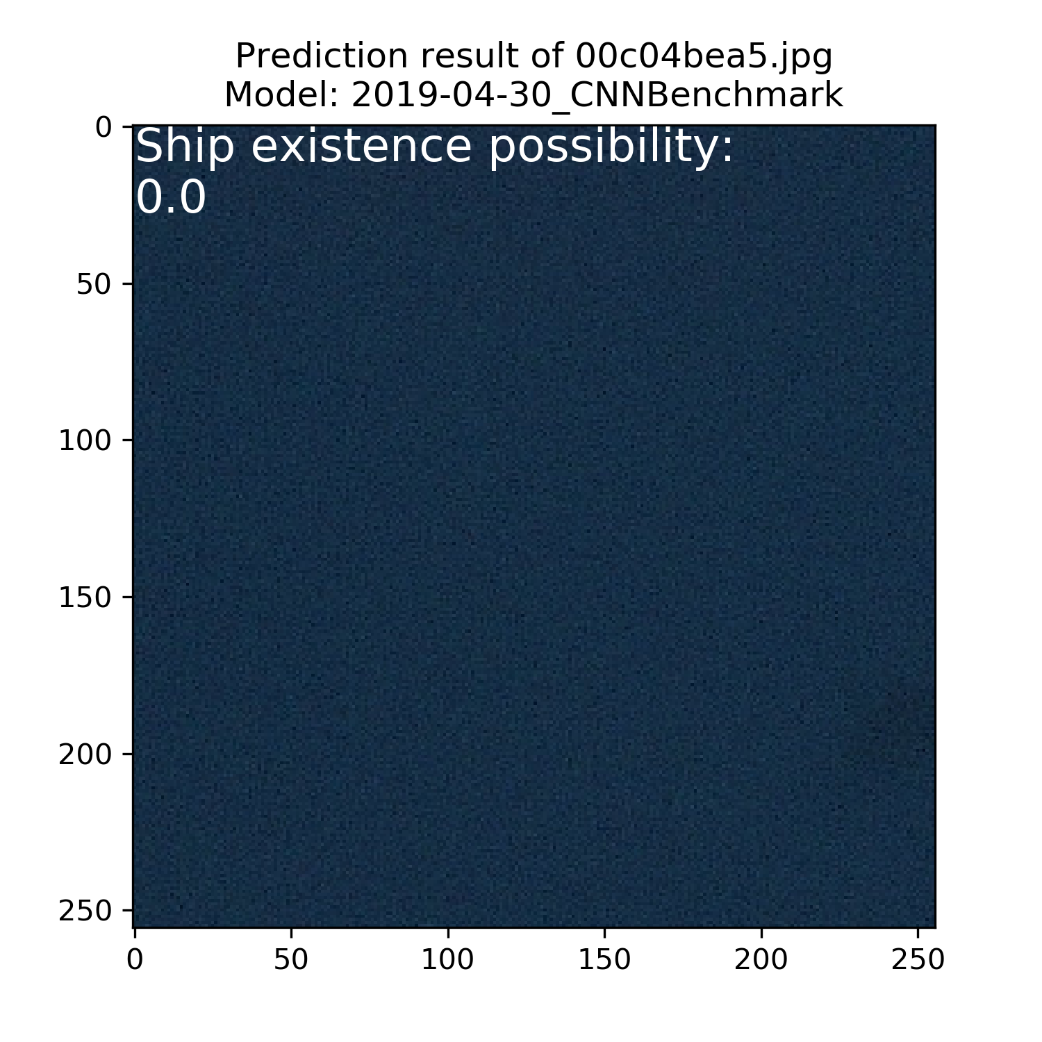
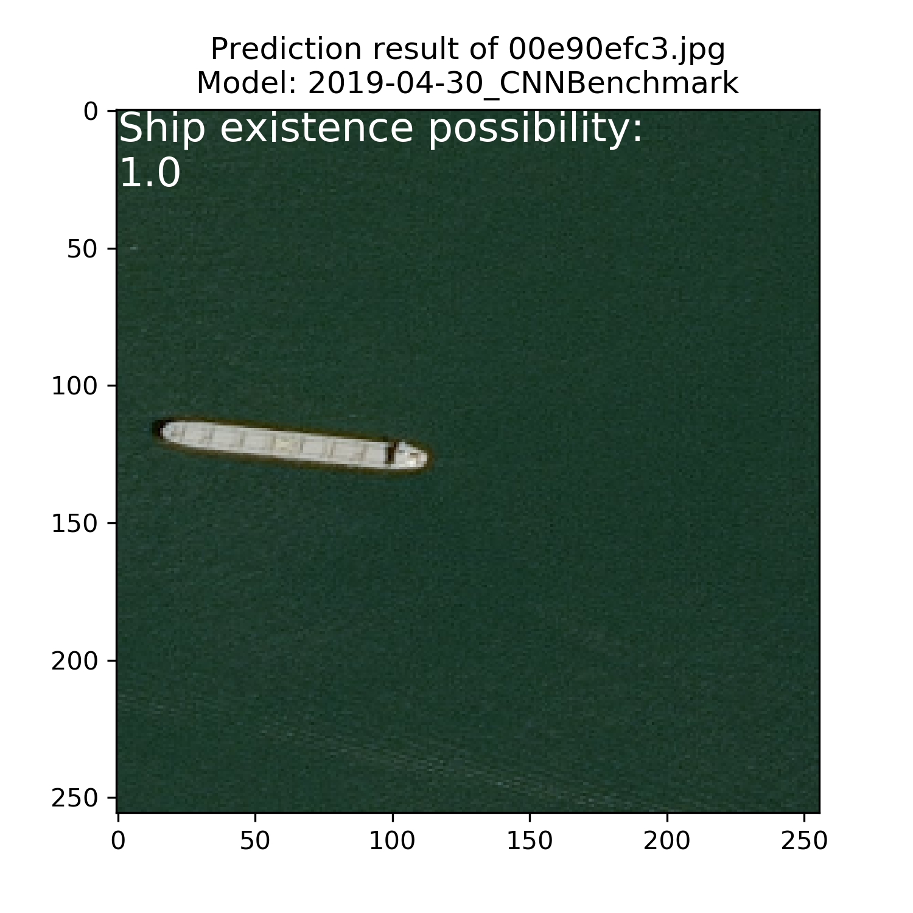
Prediction Result
Matplotlib-pyplot
Keras “plot_model” function
Prediction of “CNNBenchmark”

Slide 26
Part 1 Introduction & Background
Part 2
Design & Implementation
Part 3 Results & Conclusion
Part 4 Further Work

Slide 27
Part 1 Introduction & Background
Part 2 Design & Implementation
Part 3
Results & Conclusion
Part 4 Further Work

Slide 28
Performance: Acc/Loss
Accuracy/loss of each model trained in small batch size = 2.
Model | Loss (Training Set) | Accuracy (Training Set) | Loss (Test Set) | Accuracy (Test Set)
AlexNet | 5.2110 | 0.6767 | 5.6683 | 0.6483
AlexNetMod_D | 0.6319 | 0.6735 | 0.6462 | 0.6521
AlexNetMod_D_F | N/A | N/A | N/A | N/A
AlexNetMod_D_F_KS | 0.6318 | 0.6736 | 0.6529 | 0.6485
CNNBenchmark | 0.3372 | 0.8743 | 0.3332 | 0.8780
ResNet50PT | 5.1706 | 0.6792 | 5.6683 | 0.6483
VGG16Mod_D_F | 0.2111 | 0.9226 | 0.2076 | 0.9228
VGG16PT | 5.3174 | 0.6701 | 5.6392 | 0.6501
VGG16 | 10.7499 | 0.3257 | 10.2594 | 0.3565
N/A: Model is not trained, performance result is “Not Applicable”.

Slide 29
Performance: Acc/Loss
Accuracy/loss of each model trained in large batch size.
Model | Loss (Training) | Accuracy (Training) | Loss (Test) | Accuracy (Test) | Batch Size
AlexNet | 0.2610 | 0.8952 | 0.2747 | 0.8891 | 250
AlexNetMod_D | 0.2540 | 0.9008 | 0.2576 | 0.8958 | 250
AlexNetMod_D | 0.2937 | 0.8795 | 0.2797 | 0.8820 | 1000
AlexNetMod_D_F | 0.2296 | 0.9124 | 0.2557 | 0.8972 | 250
AlexNetMod_D_F_KS | 0.1768 | 0.9341 | 0.1926 | 0.9317 | 250
CNNBenchmark | 0.2112 | 0.9181 | 0.2511 | 0.9014 | 250
ResNet50PT | 5.2252 | 0.6758 | 5.5897 | 0.6532 | 100
ResNet50PT | 5.2767 | 0.6726 | 5.5897 | 0.6532 | 250
VGG16Mod_D_F | 0.6141 | 0.6732 | 0.6200 | 0.6532 | 250
VGG16PT | 0.2452 | 0.9075 | 0.2242 | 0.9152 | 100
VGG16 | OOM | OOM | OOM | OOM | 100
VGG16 | OOM | OOM | OOM | OOM | 250
OOM: Model is not implemented due to “Out of Memory”.

Slide 30
Performance: Time Use
Training time of each model trained by different batch size.
Model | Small Batch Size = 2 | Large Batch Size | #Batch Size
AlexNet | 29616.53125 | 8879.78125 | 250
AlexNetMod_D | 23853.53125 | 8939.703125 | 250
 |  | 9122.53125 | 1000
AlexNetMod_D_F | N/A | 8756.59375 | 250
AlexNetMod_D_F_KS | 23967.28125 | 9188.78125 | 250
CNNBenchmark | 22478.203125 | 9175.546875 | 250
ResNet50PT | 39091.6875 | 10414.4375 | 100
 |  | 10176.125 | 250
VGG16Mod_D_F | 24896.0 | 9461.4375 | 250
VGG16PT | 26638.0 | 11202.546875 | 100
VGG16 | 31185.359375 | OOM | 100
 |  | OOM | 250
N/A: Model is not trained, performance result is “Not Applicable”.
OOM: Model is not implemented due to “Out of Memory”.

Slide 31
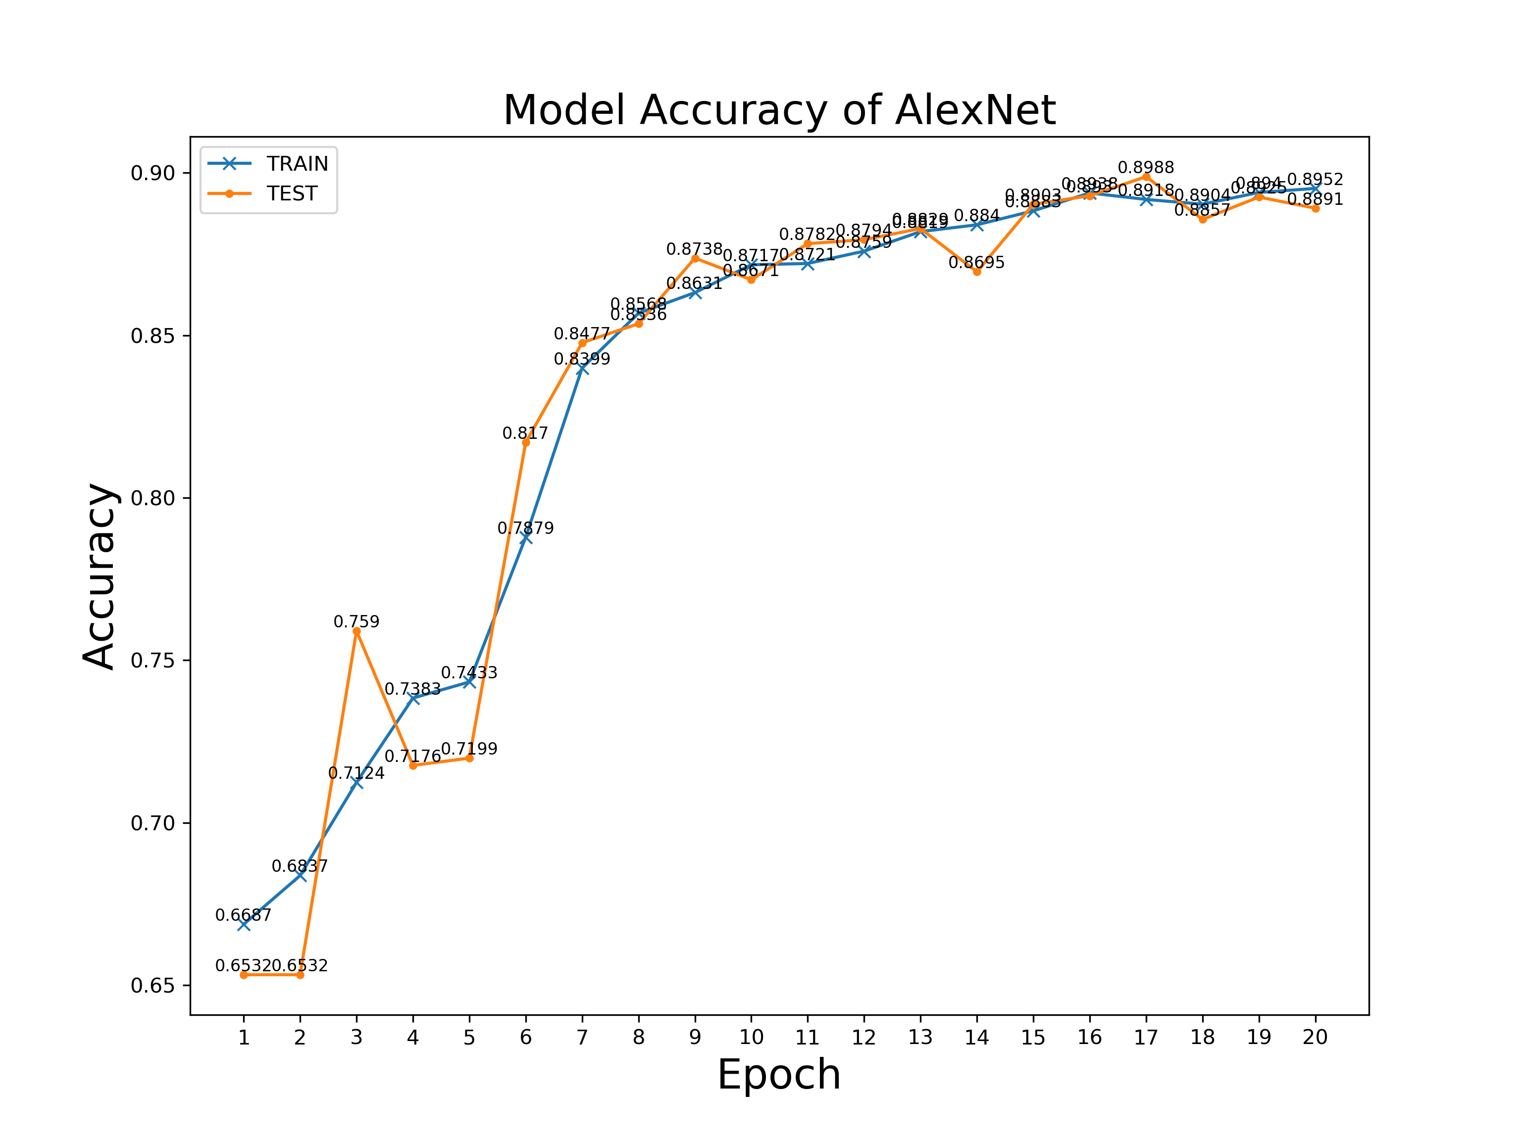
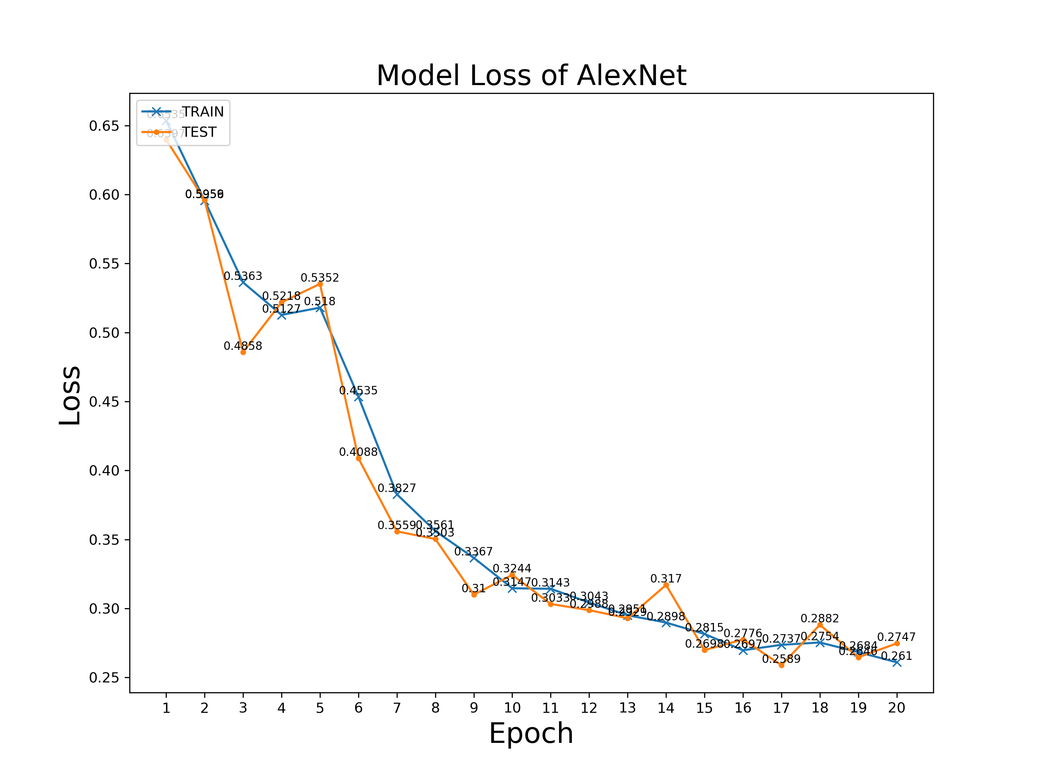
Performance Visualisation
AlexNet @ Batch Size = 250

Slide 32
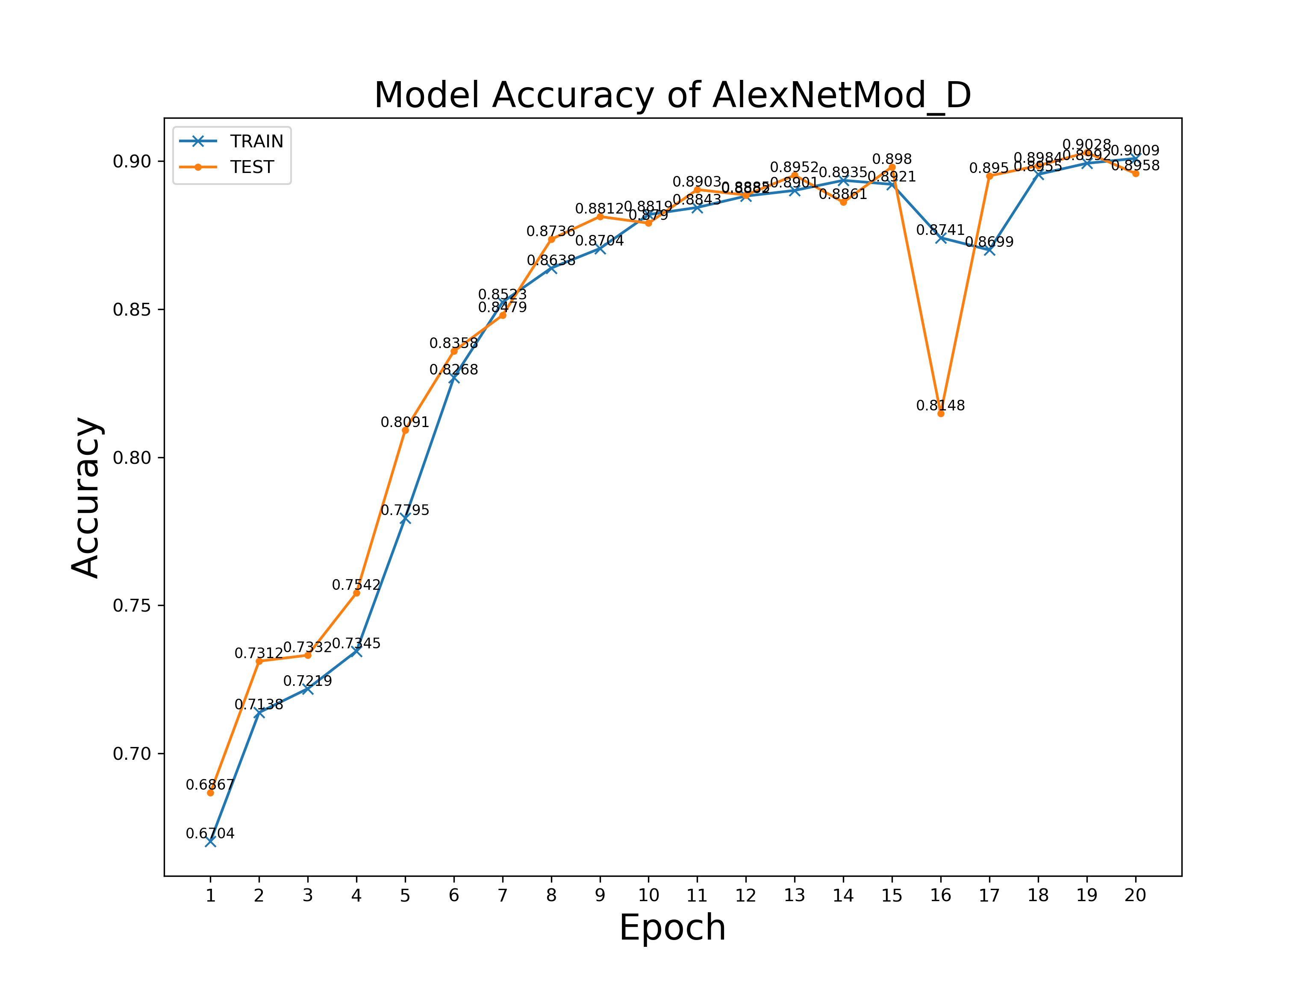
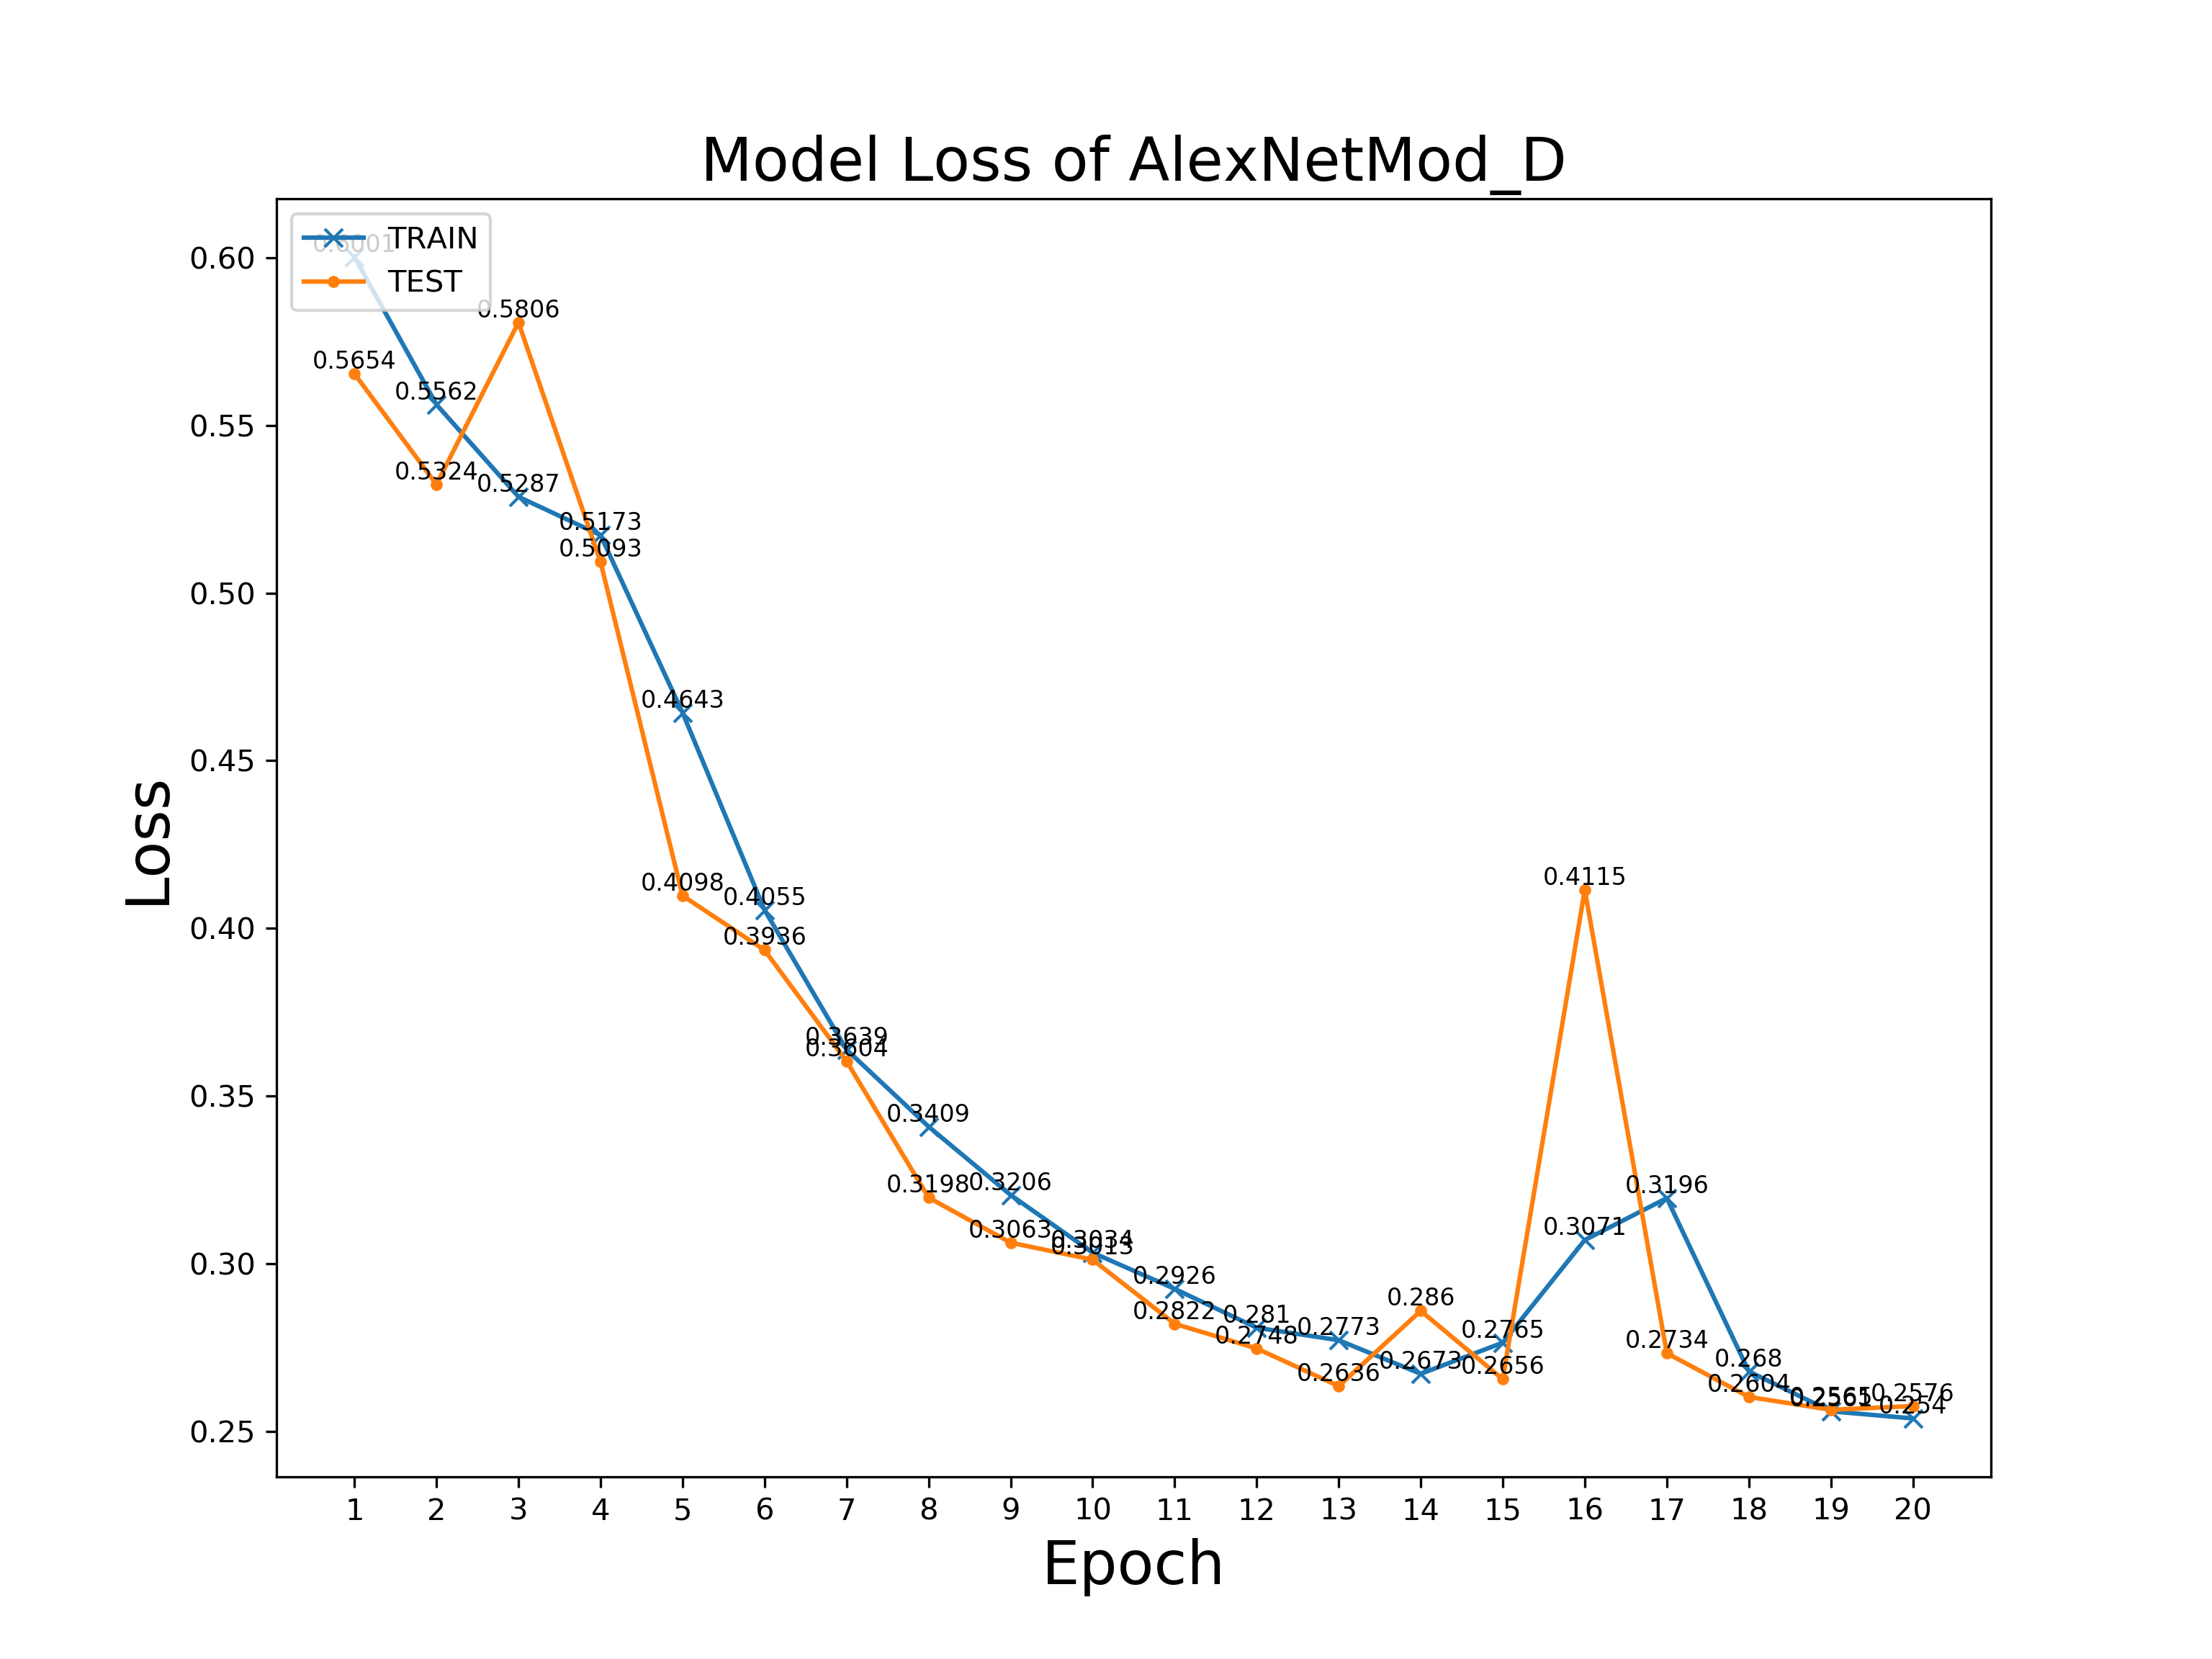
Performance Visualisation
AlexNetMod_D @ Batch Size = 250

Slide 33
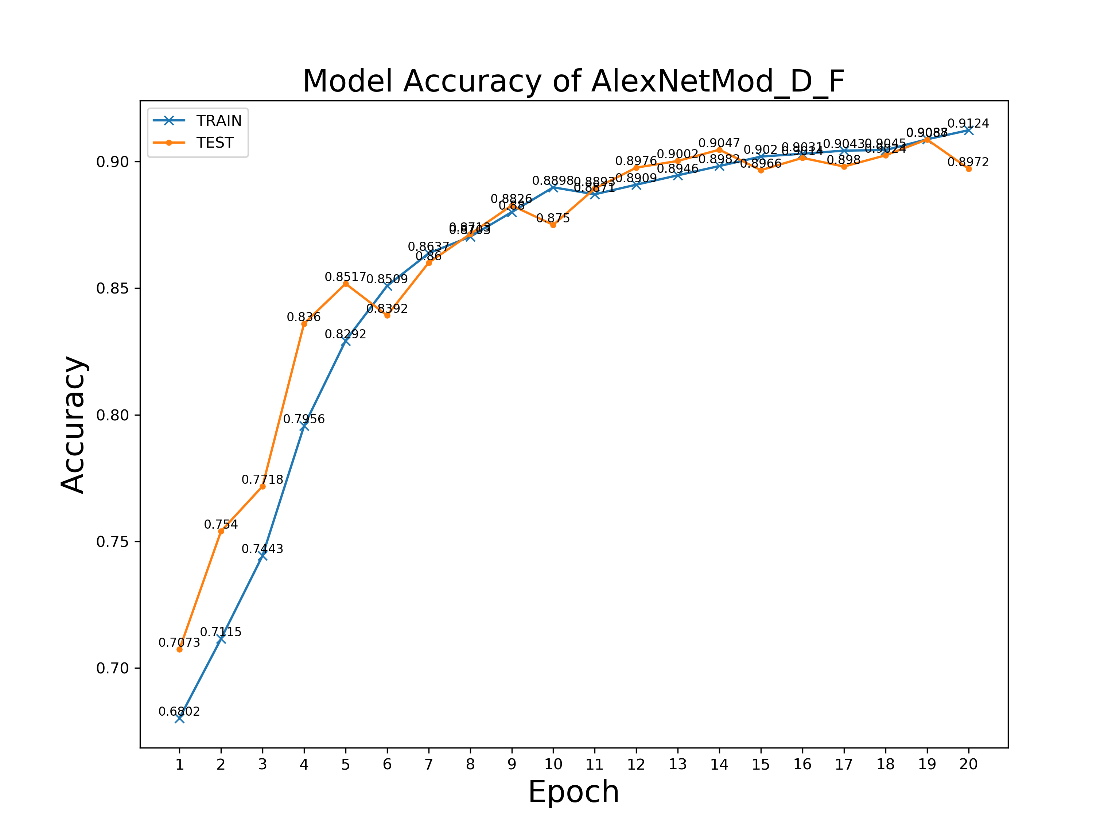
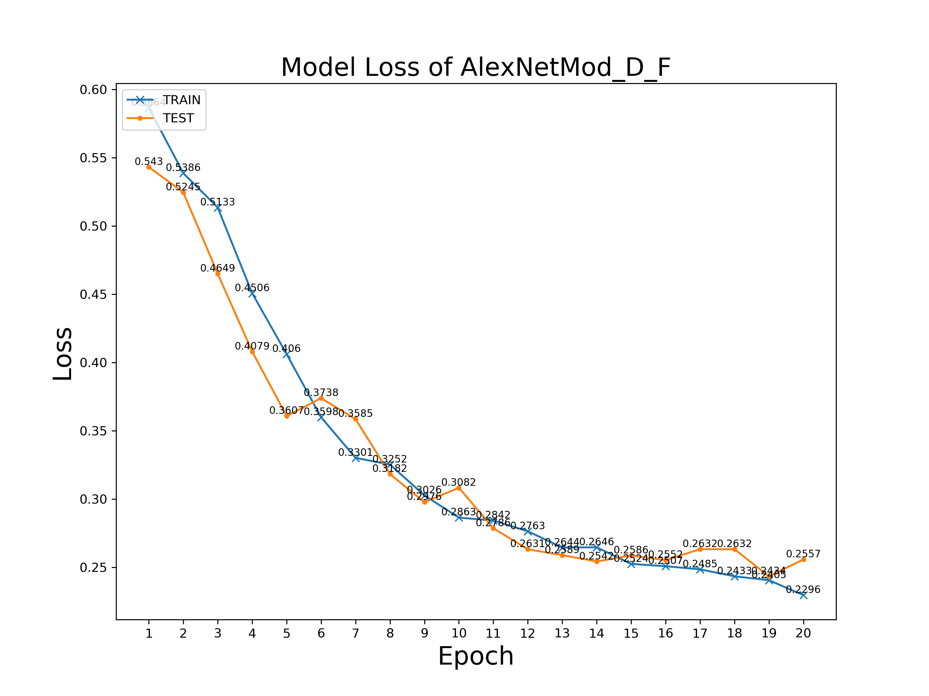
Performance Visualisation
AlexNetMod_D_F @ Batch Size = 250

Slide 34
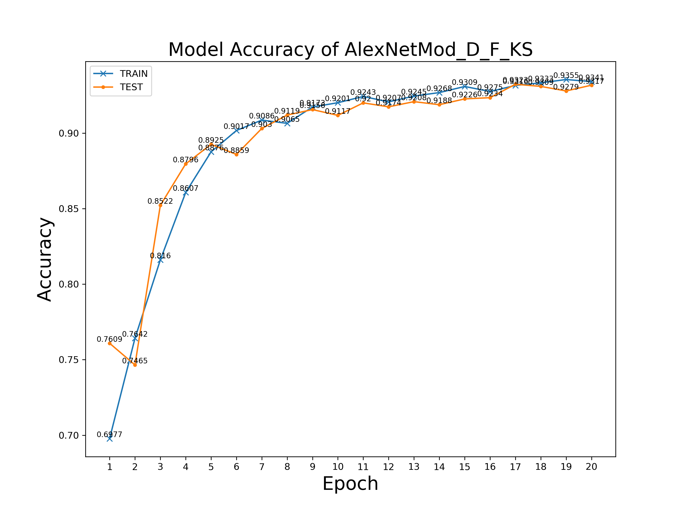
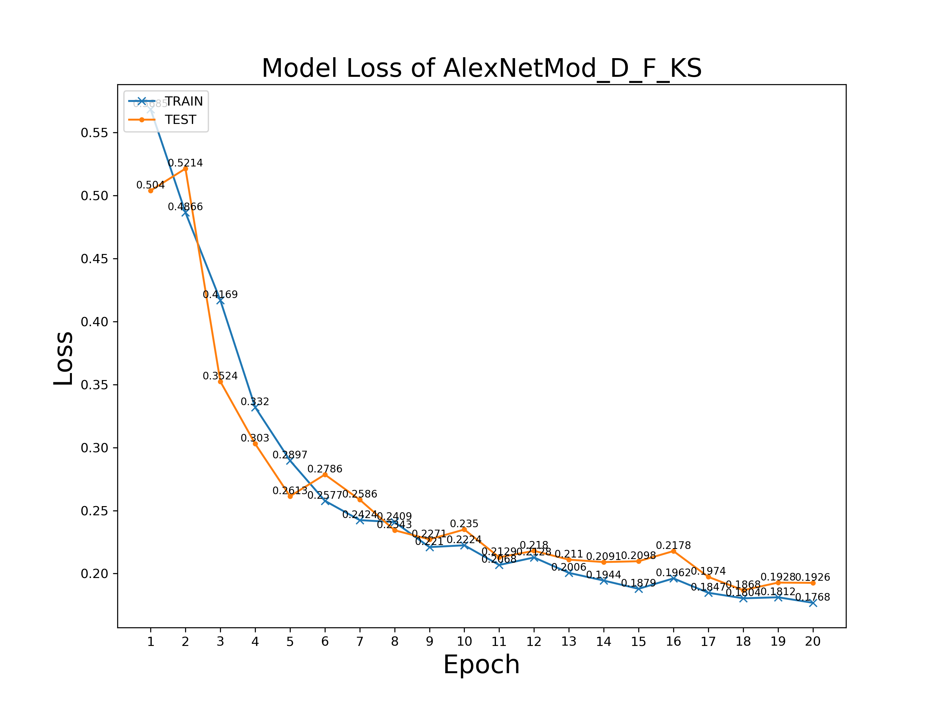
Performance Visualisation
AlexNetMod_D_F_KS @ Batch Size = 250

Slide 35
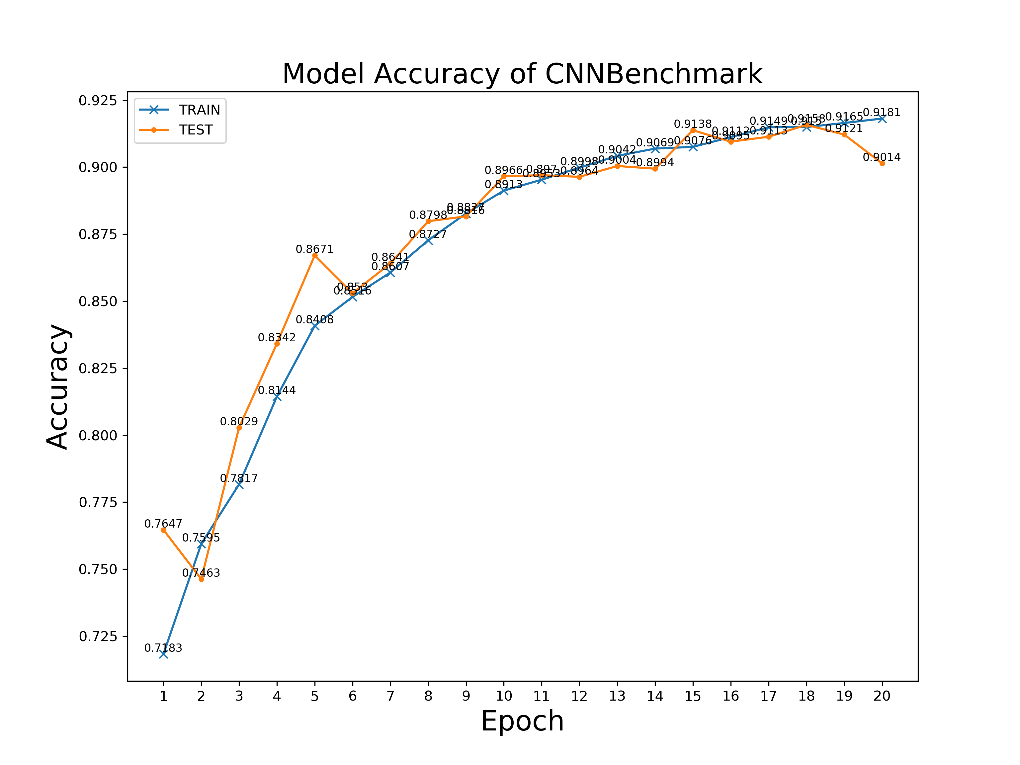
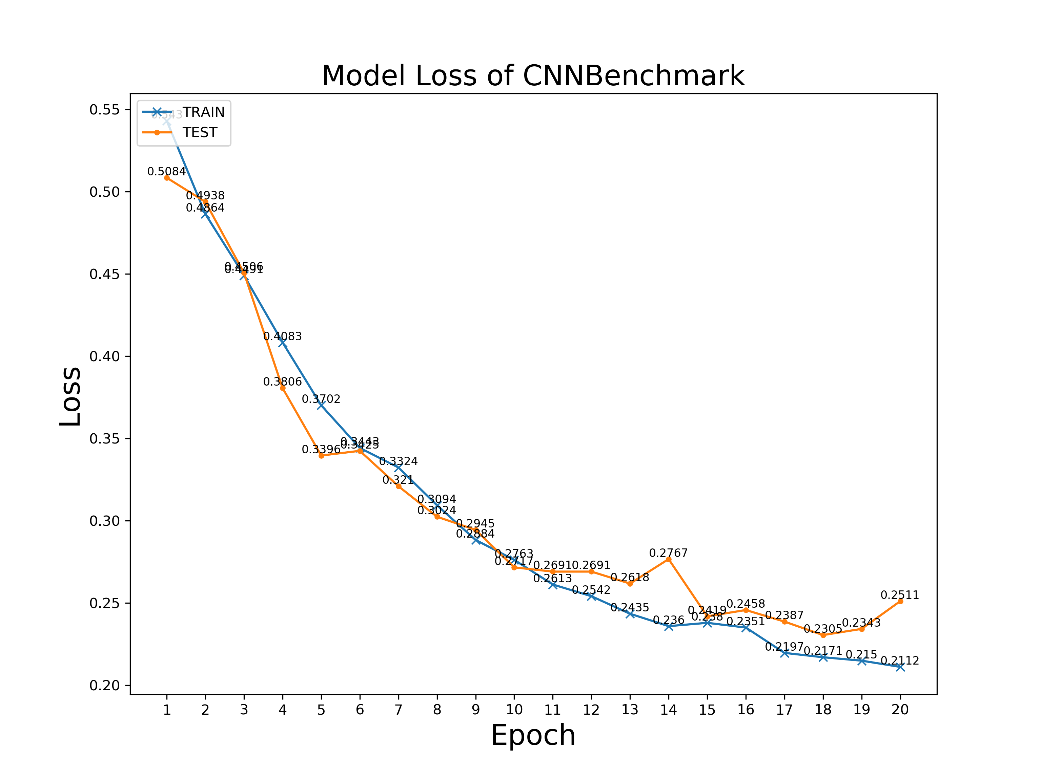
Performance Visualisation
CNNBenchmark @ Batch Size = 250

Slide 36
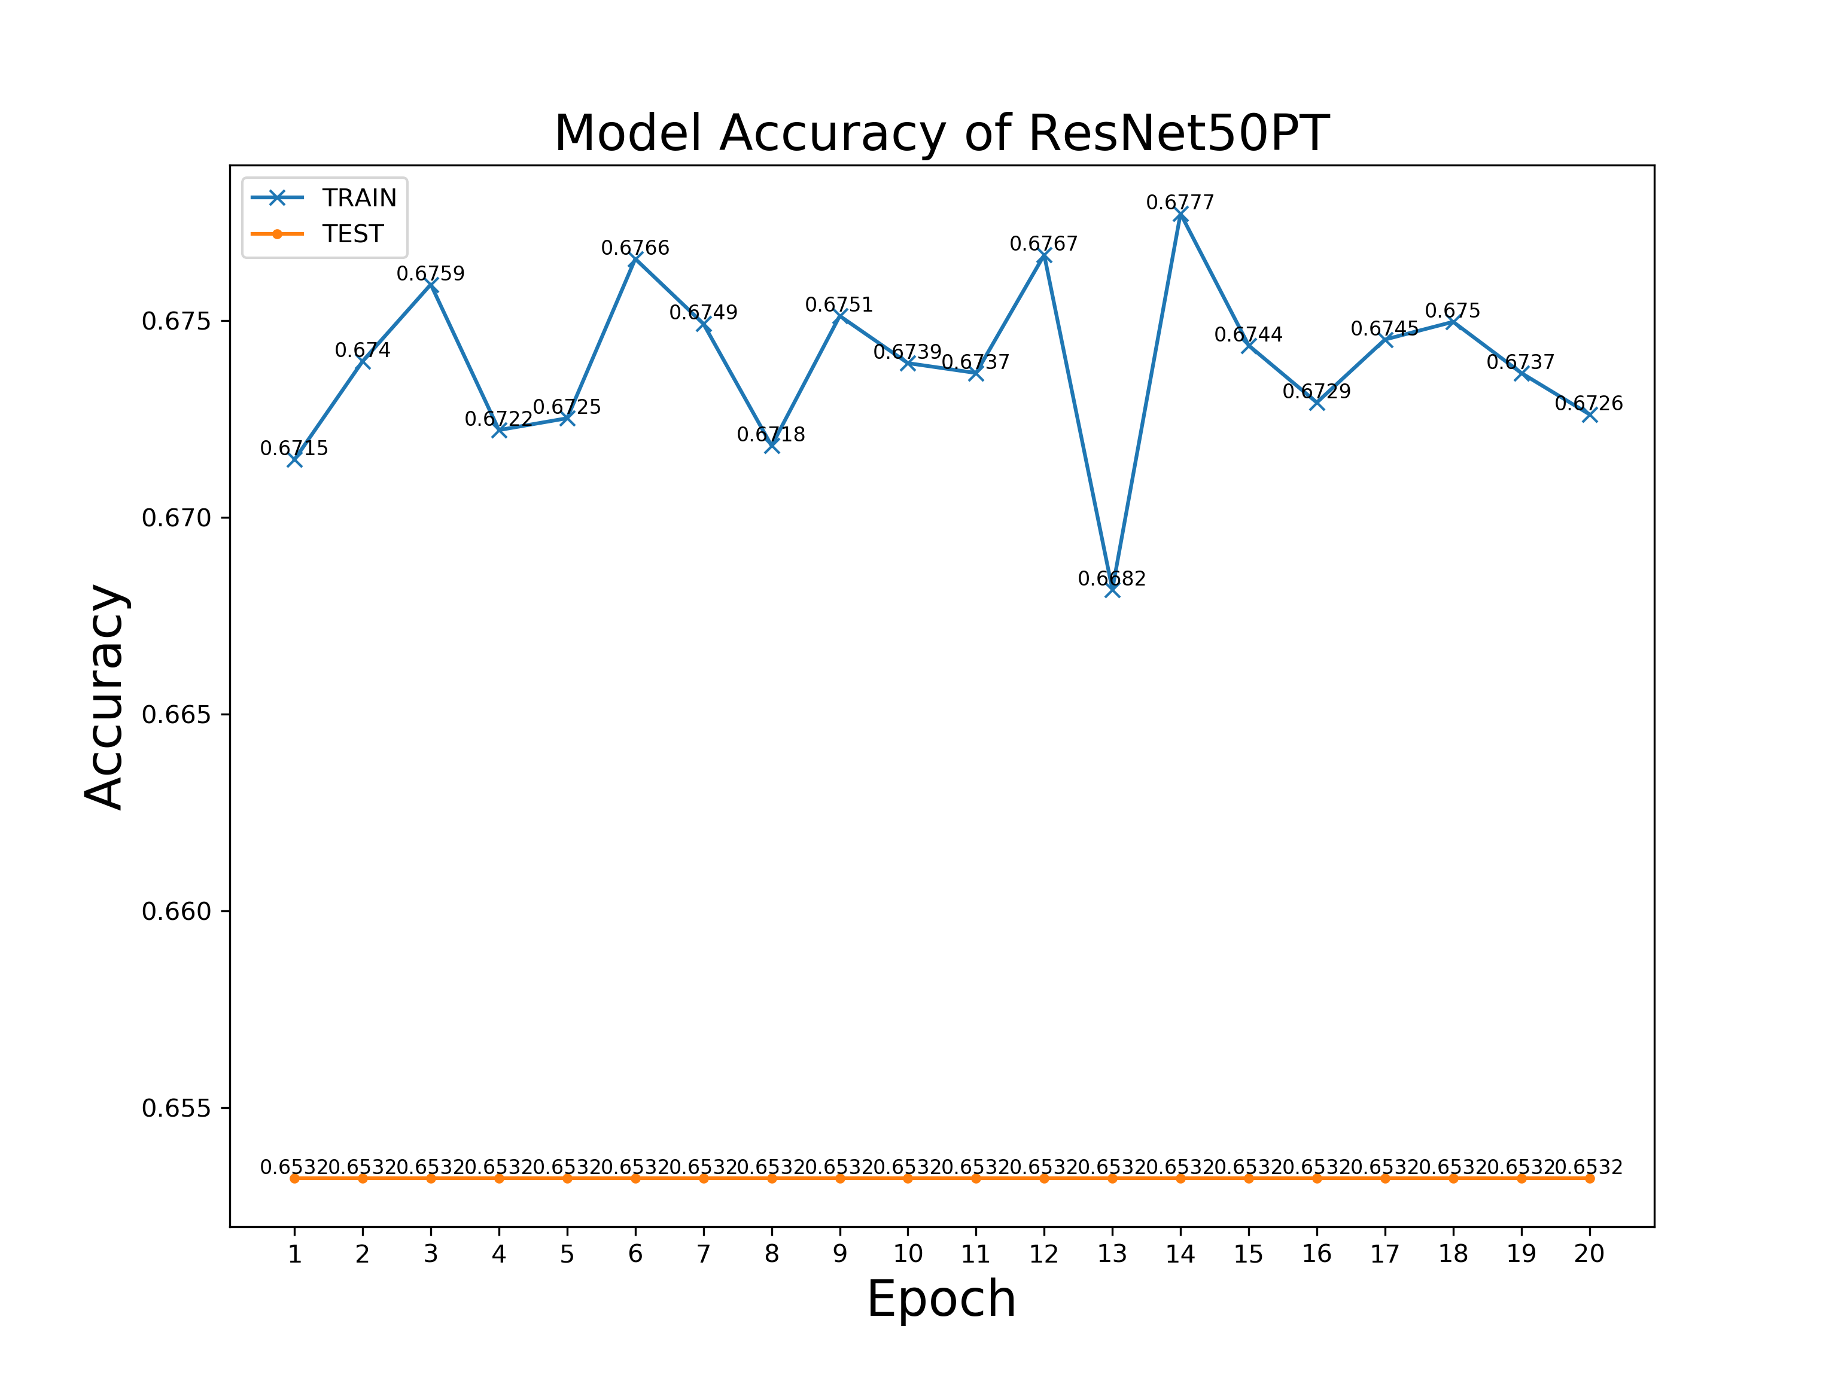
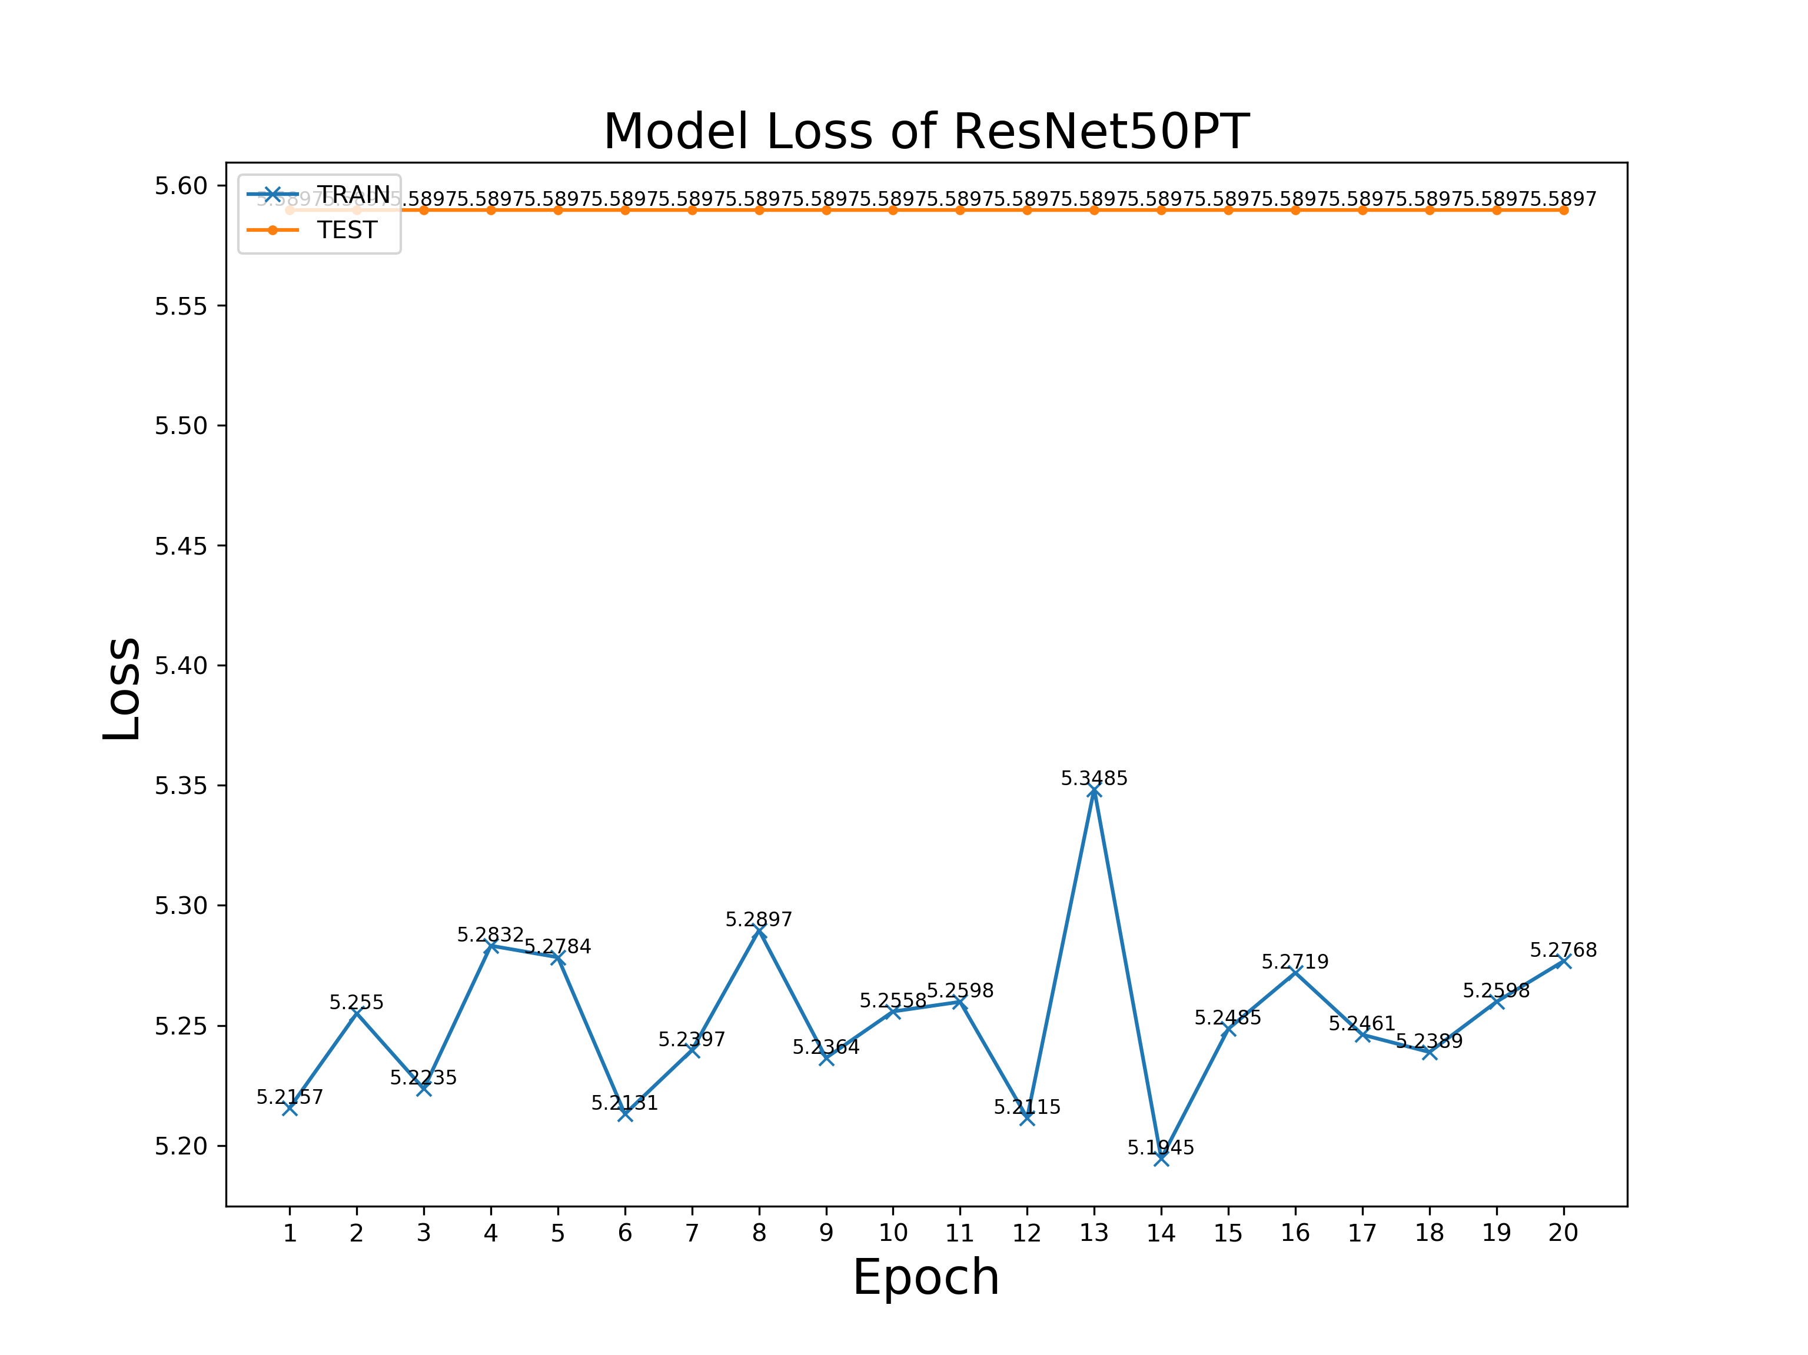
Performance Visualisation
ResNet50PT @ Batch Size = 250

Slide 37
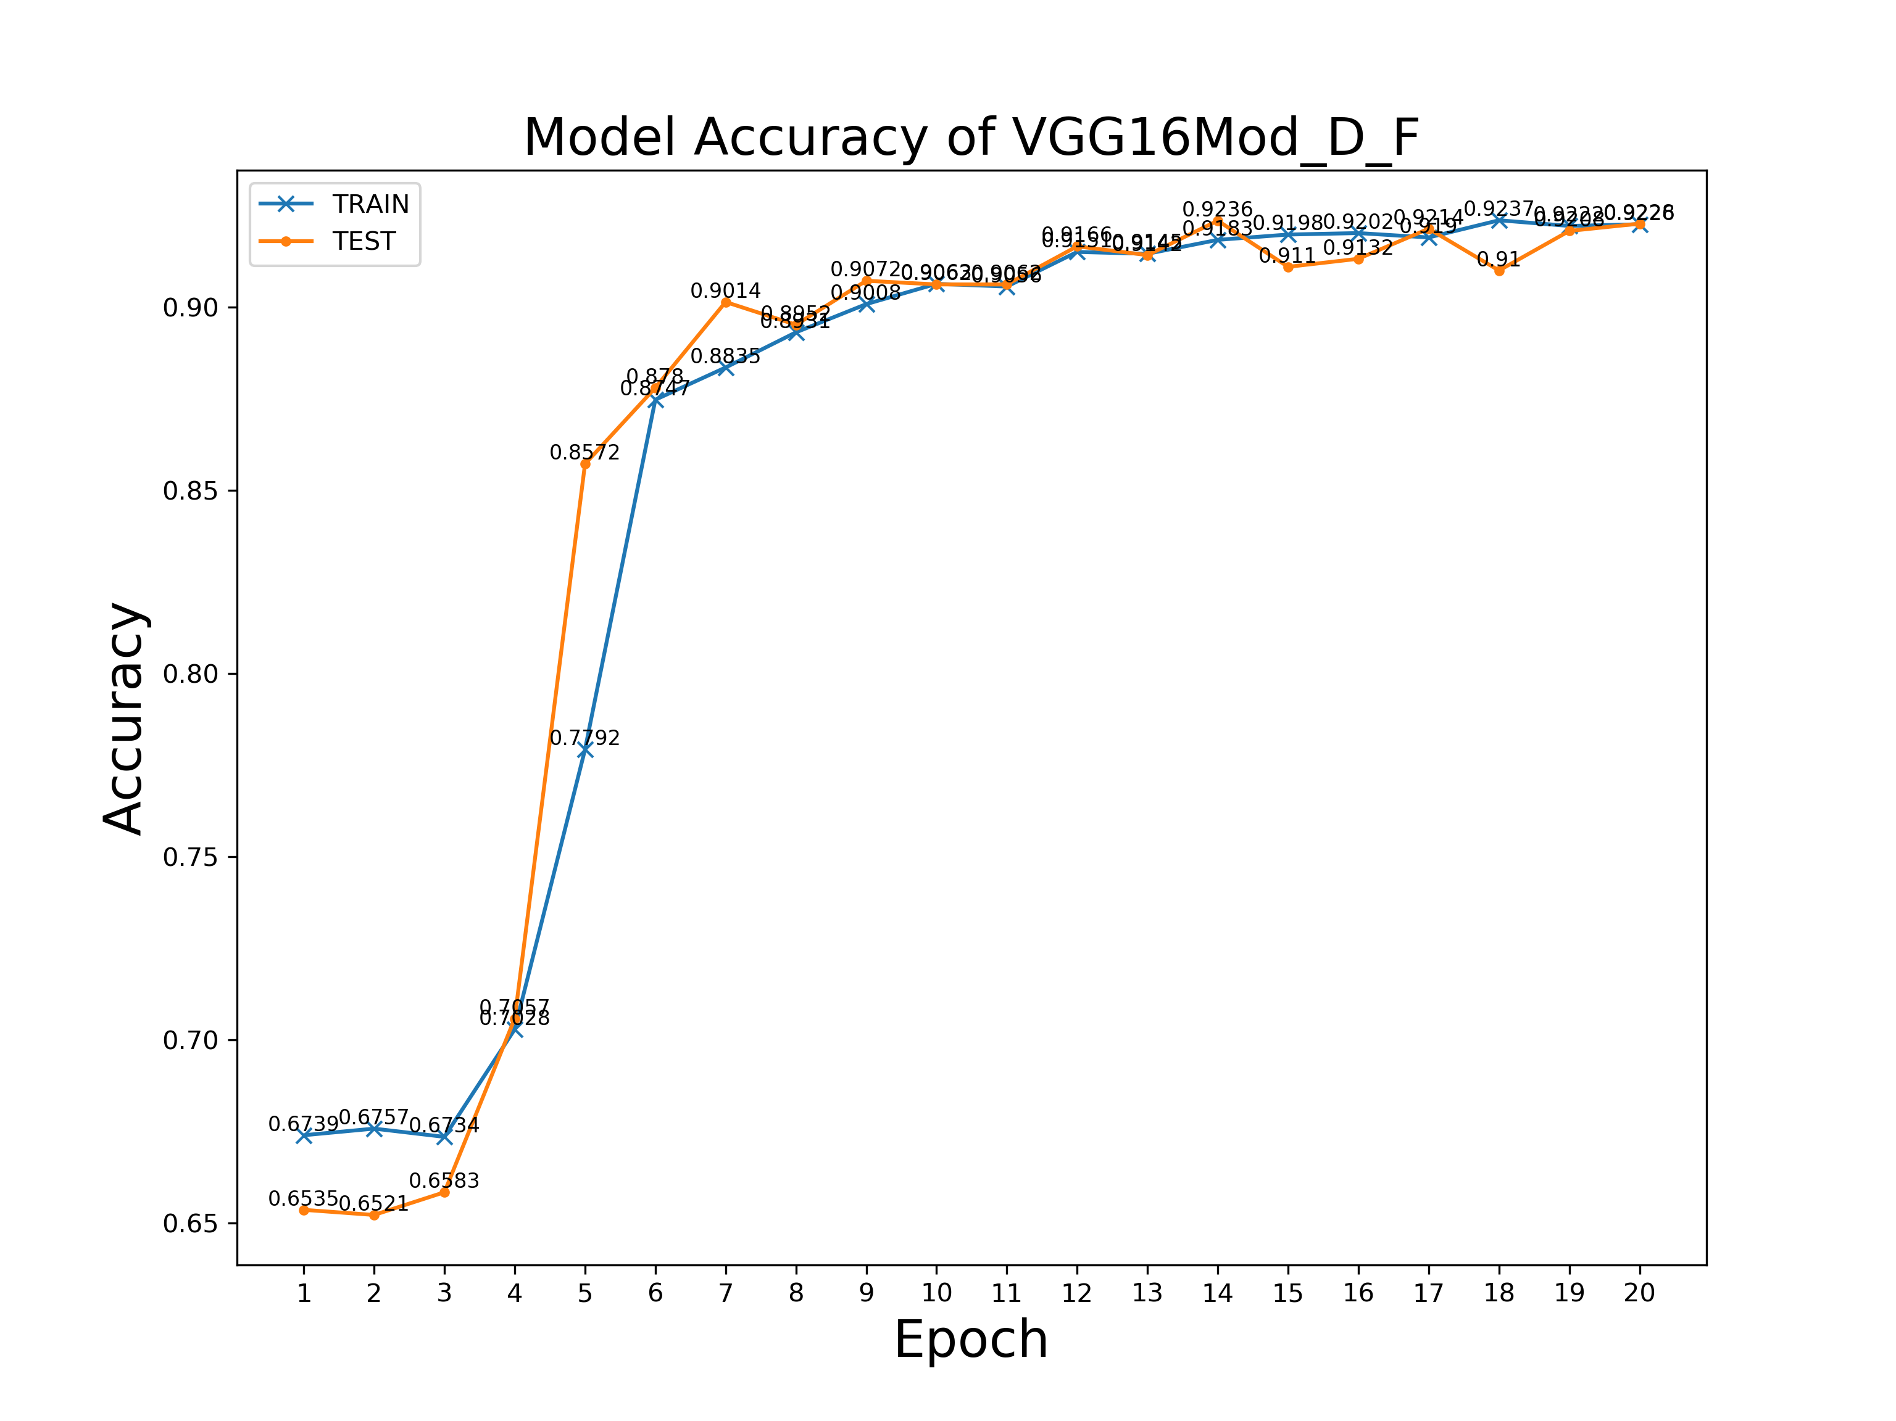
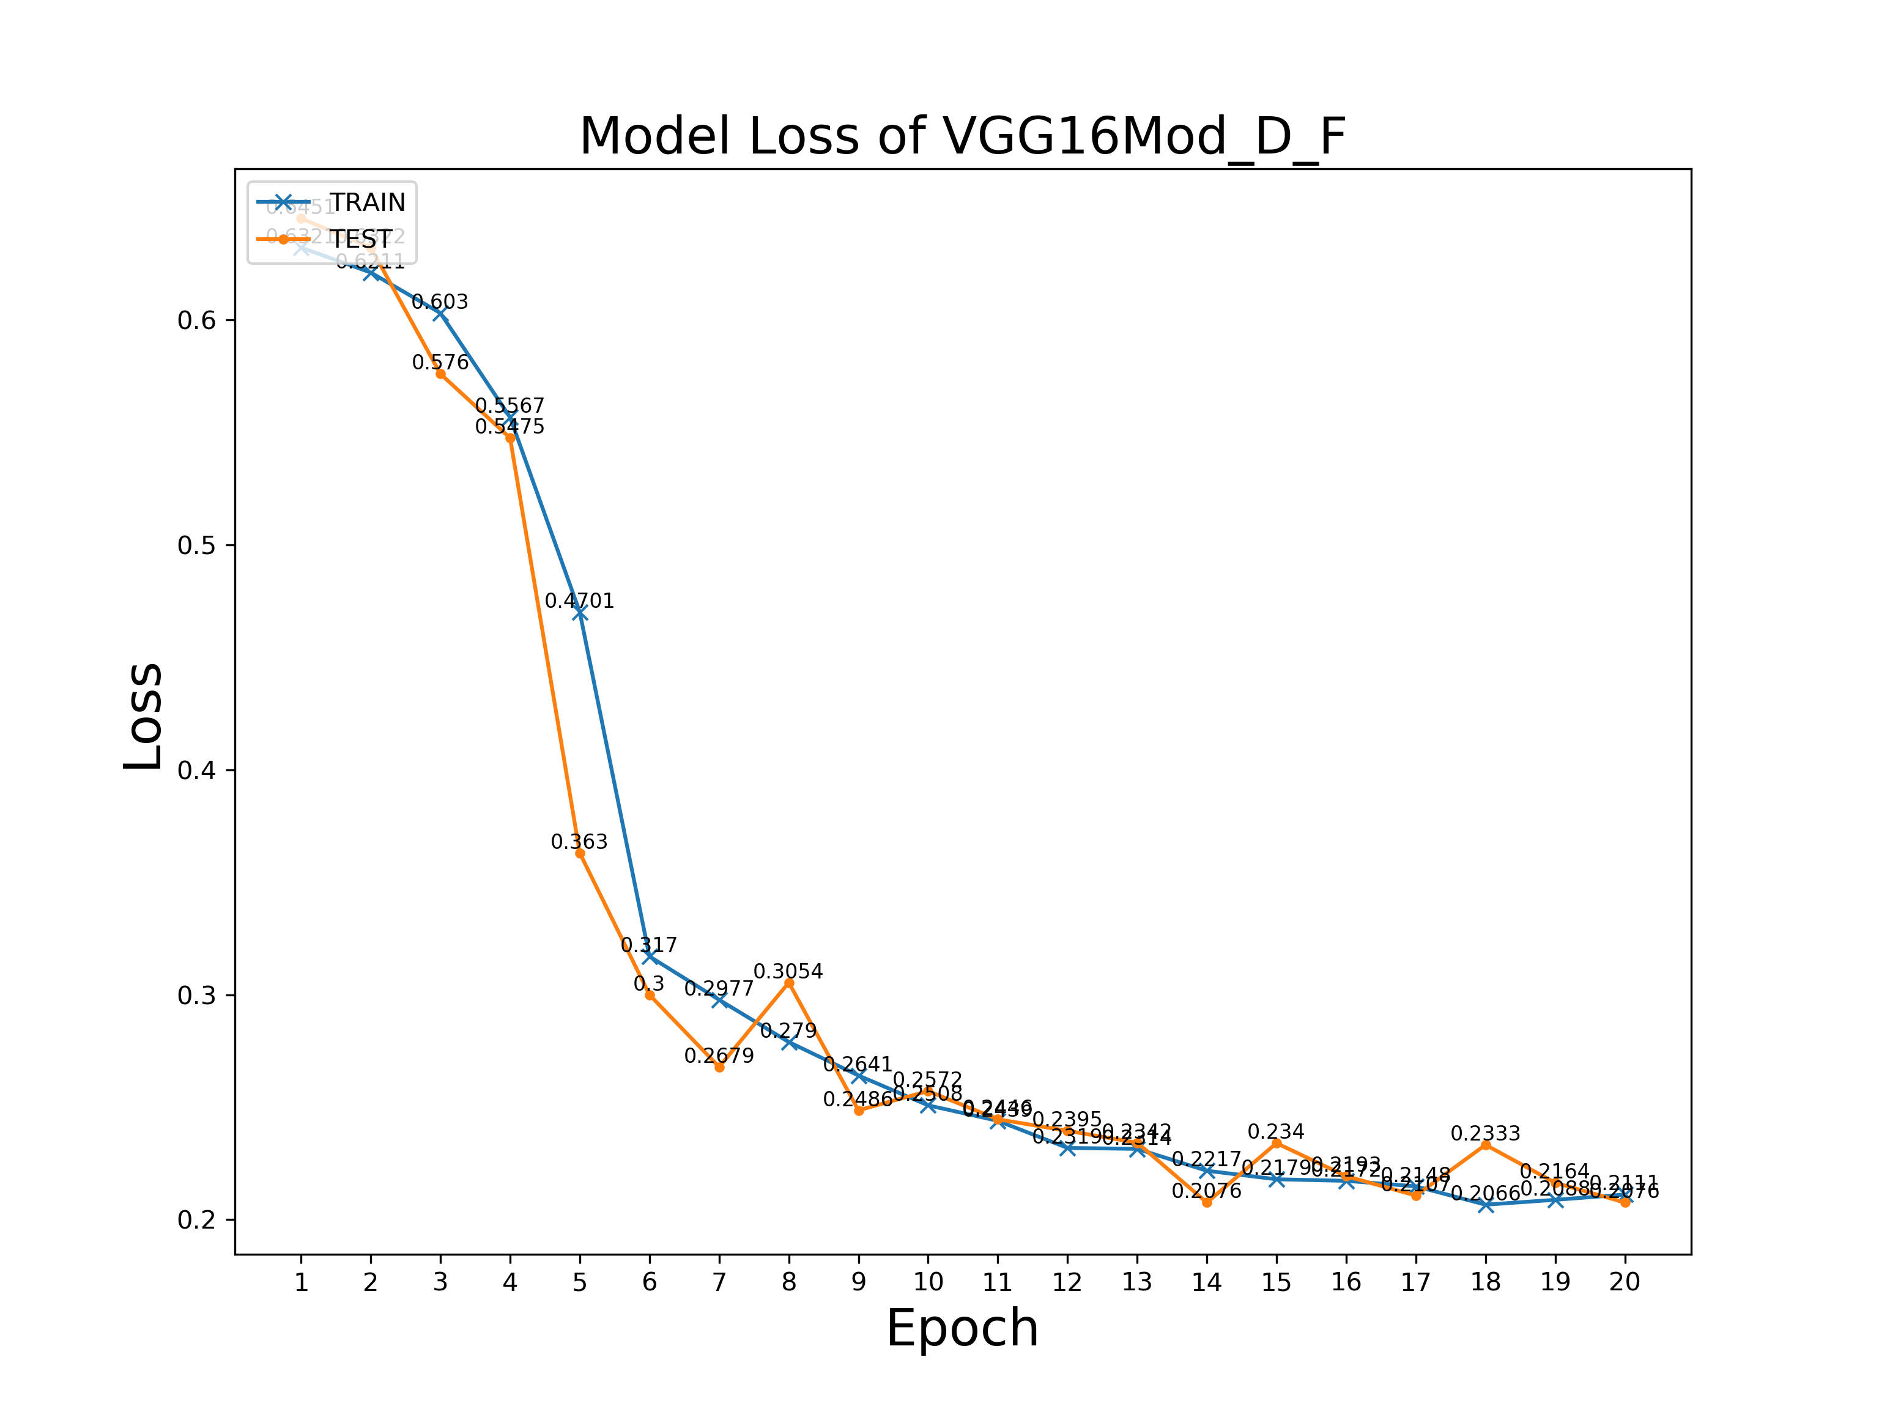
Performance Visualisation
VGG16Mod_D_F @ Batch Size = 2

Slide 38
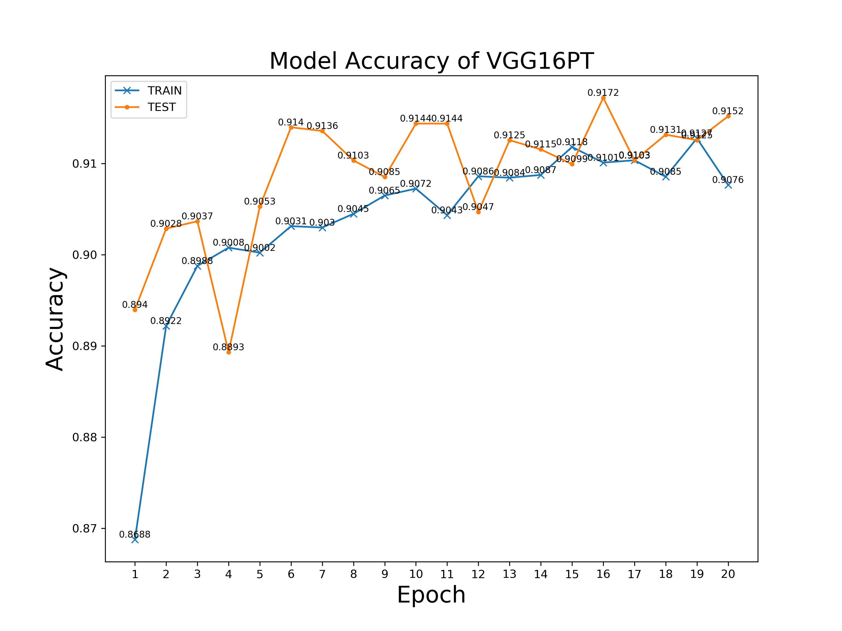
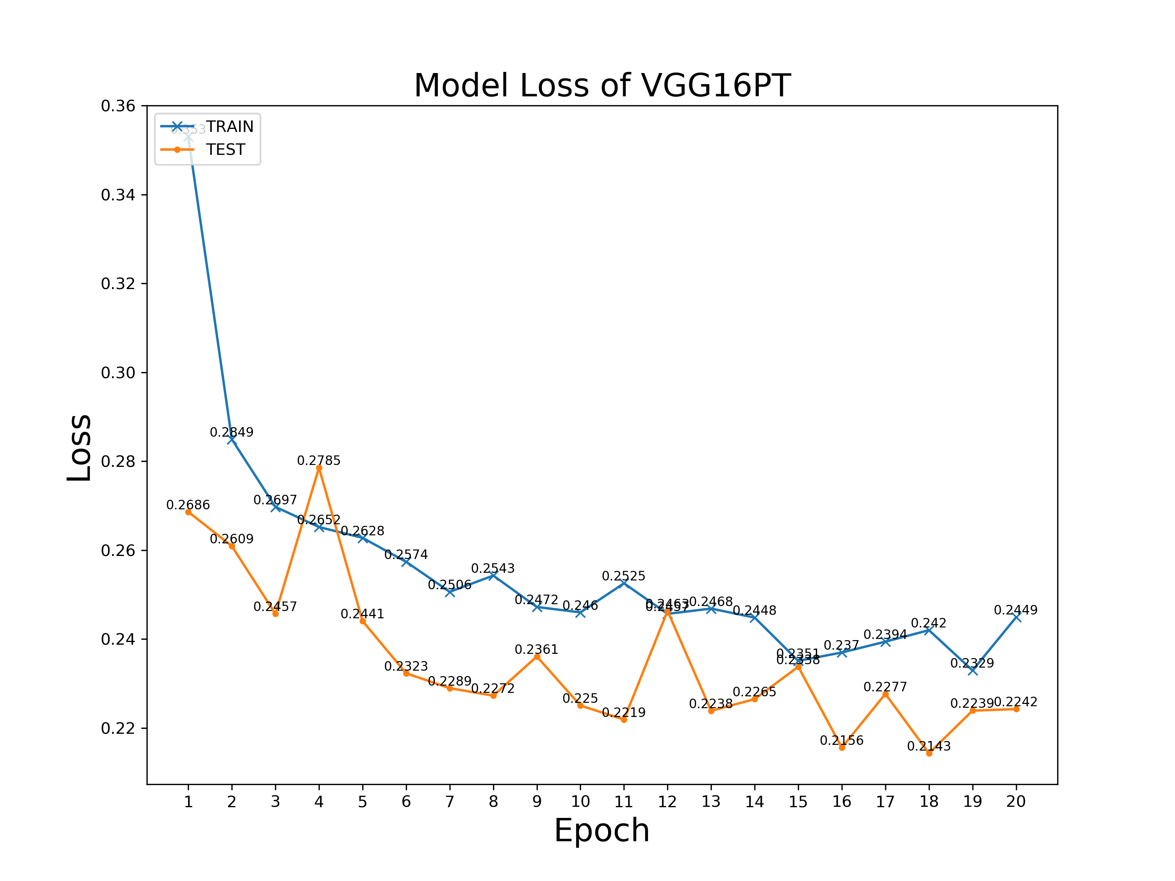
Performance Visualisation
VGG16PT @ Batch Size = 100

Slide 39
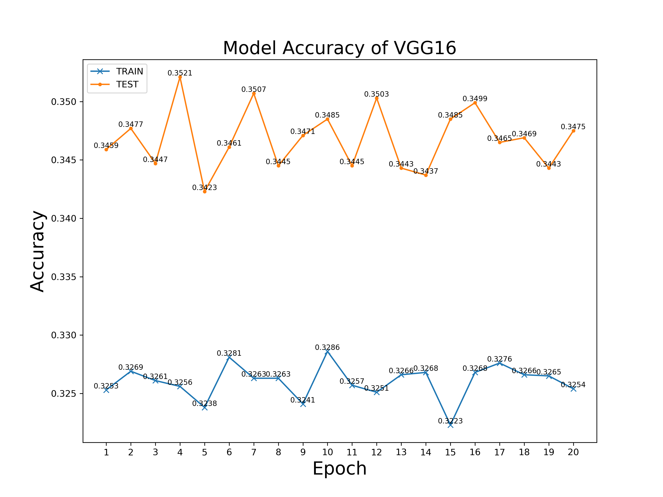
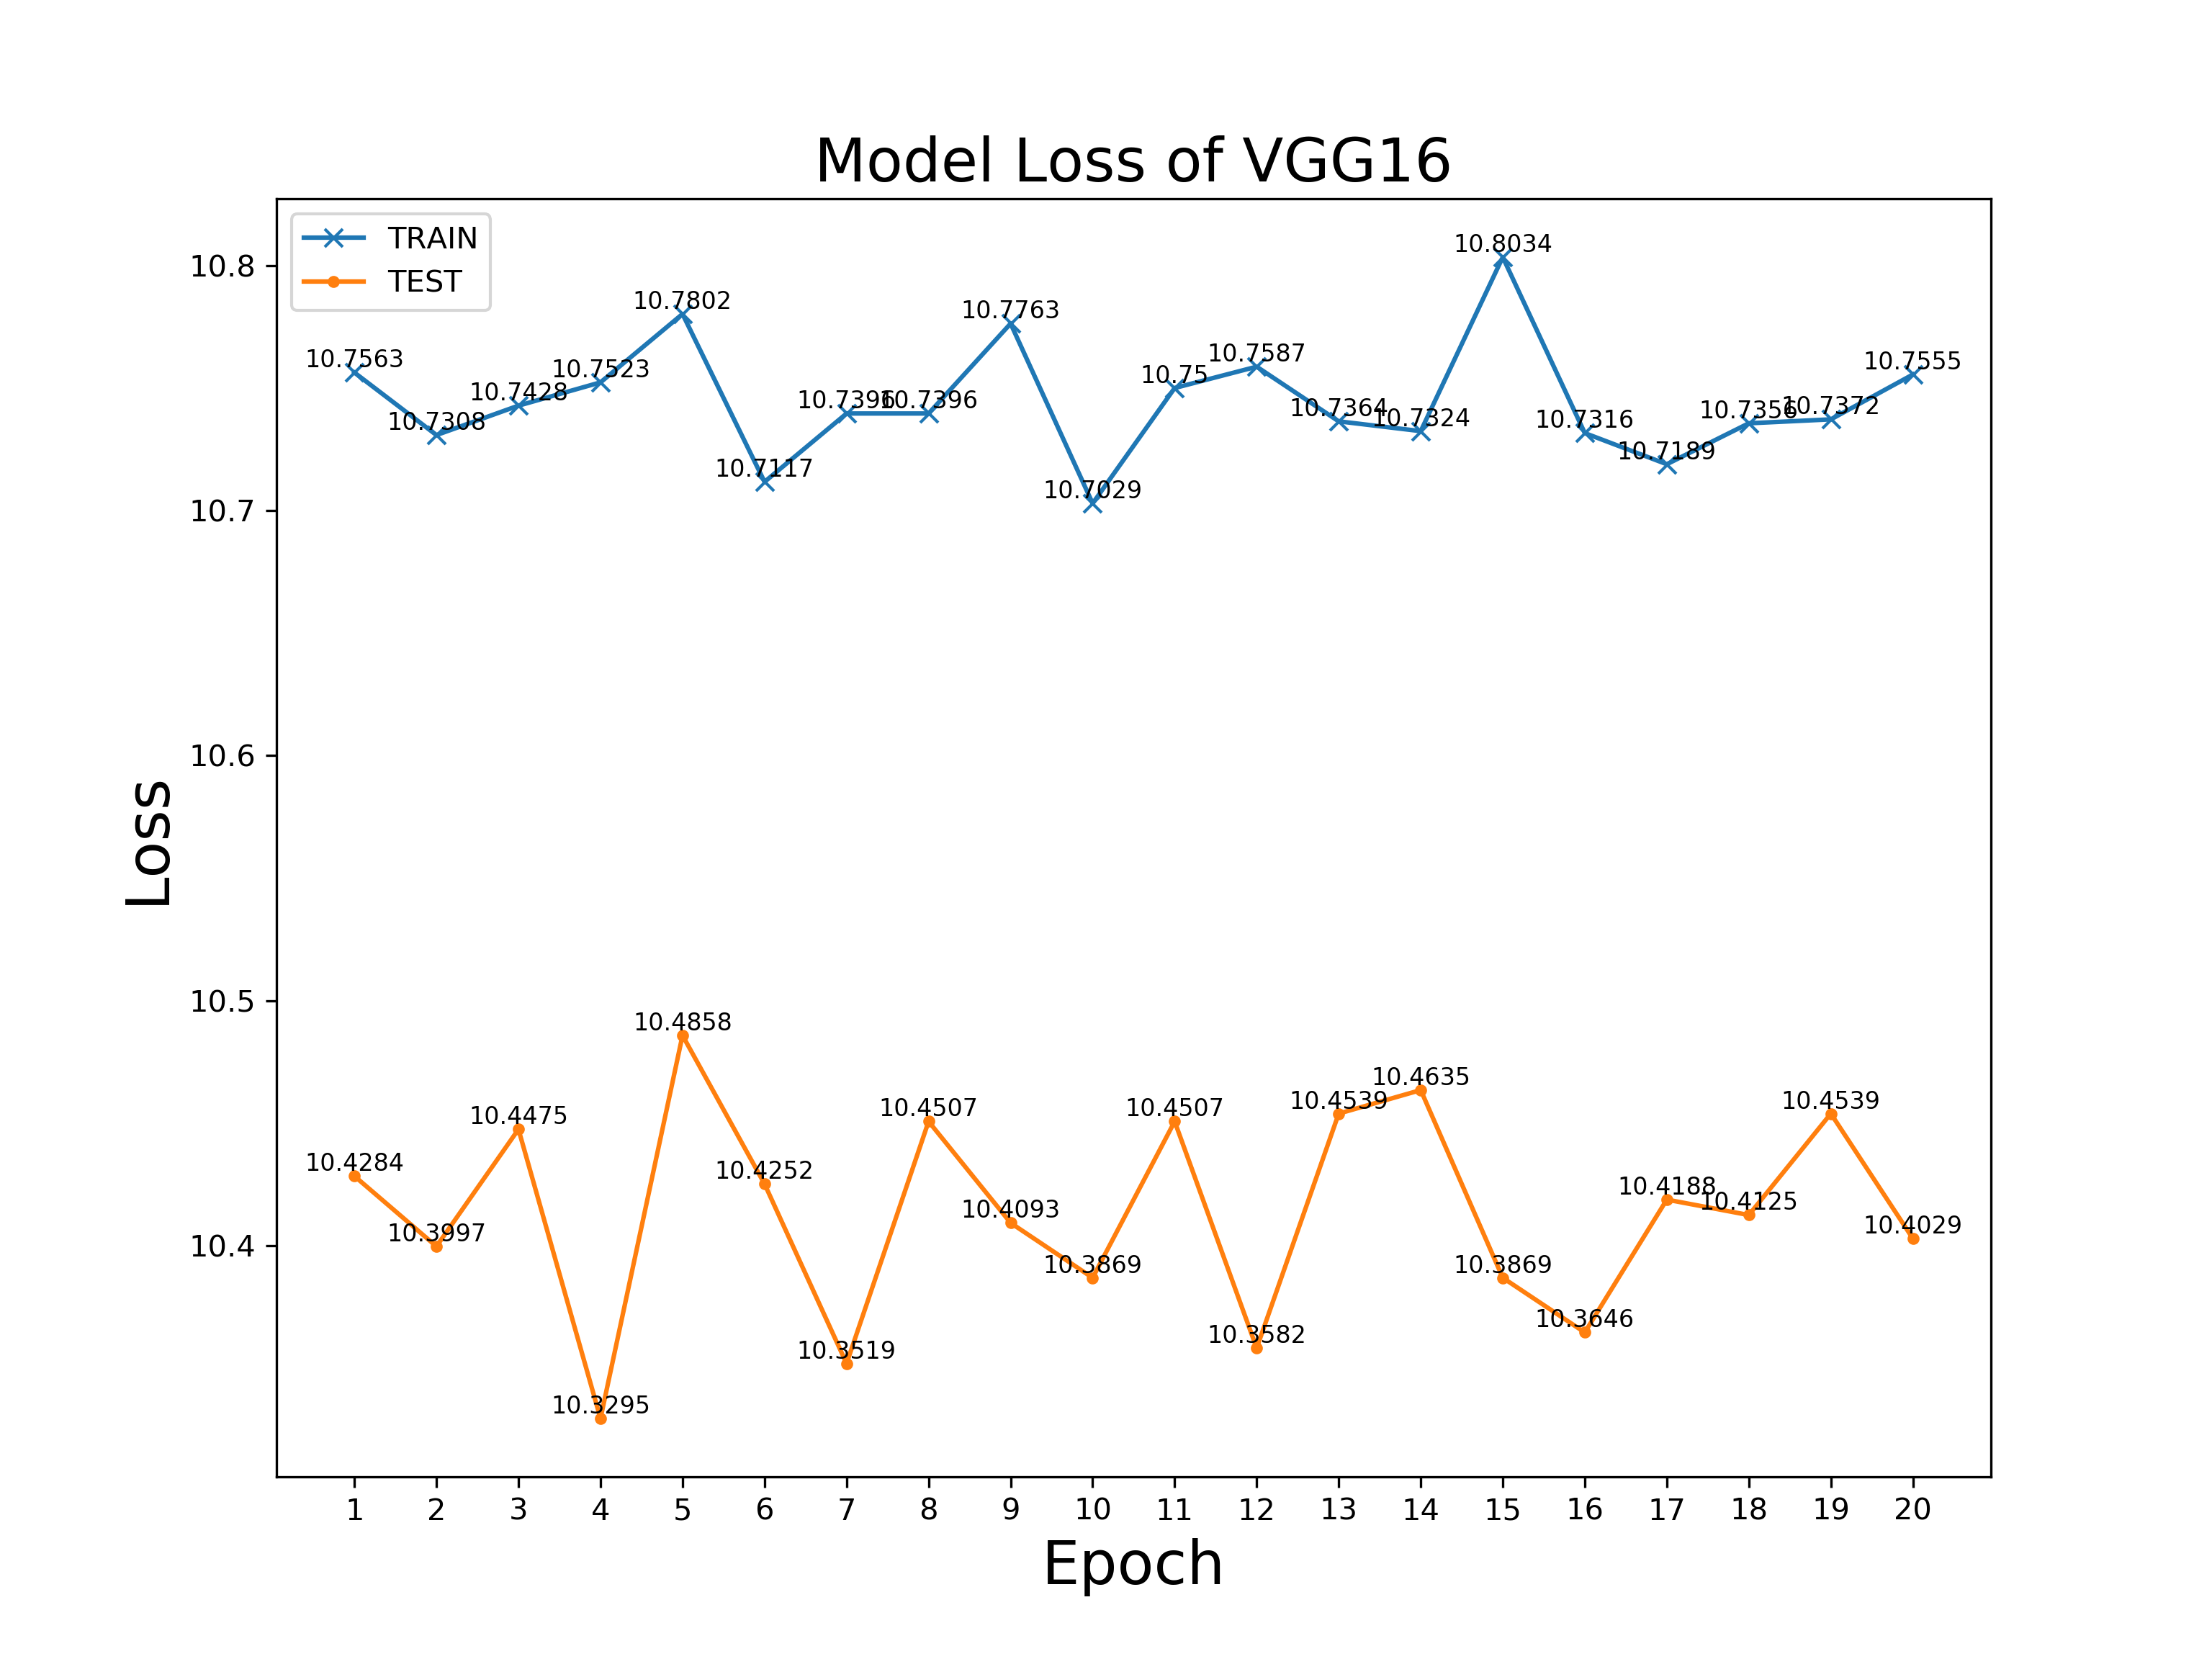
Performance Visualisation
VGG16 @ Batch Size = 2

Slide 40










Conclusion
Outcomes
Analysis Result
Statistics
Image Augmentation Demo
Models & Weight
History & Logs
Architecture Summary
Performance Indices
Prediction Result

Slide 41
Conclusion
Outcomes
Menu | Generated File | Description
Analysis | TrainingSetAnalysis.csv | Dataset attribute
 | TestSetAnalysis.csv | Dataset attribute
Model Training (Pre-processing) | Statistics of Appointed Dataset Scope.png | Dataset visualisation
 | Statistics of Actual Training Set Data.png | Dataset visualisation
 | Statistics of Actual Test Set Data.png | Dataset visualisation
 | [Date]_Sample Sample.jpg train_config_*.jpg test_config_*.jpg | Data augmentation visualisation
Model Training (Actual Training) | [Date]_[ModelName]_trained_model.h5 | Fitted model
 | [Date]_[ModelName]_trained_model_weights.h5 | Model weight
 | [Date]_[ModelName]_history.txt | Training history
Evaluation | [Date]_[ModelName]_Accuracy.png | Accuracy visualisation
 | [Date]_[ModelName]_Loss.png | Loss visualisation
 | [Date]_[ModelName]_Summary.svg | Architecture visualisation
 | [Date]_[ModelName]_Prediction_[ImageId].png | Prediction visualisation
All Features | [Date]_log.txt | Application log

Slide 42

Conclusion
Performance Factors
Depth of model architecture
Number of filters
Increase on model architecture depth is not proportional to model accuracy improvement.
Cropping the number of filters can improve the accuracy.
Kernel size & strides
Batch size on training
Selecting smaller kernel size and stride can enhance the accuracy;
May cause OOM in some devices.

Slide 43
Conclusion
Training Time Factors
Batch size of training
Scale of dataset
Selecting relatively large batch size can accelerate model training.
Dataset scale is proportional to time cost in training.
Number of trainable parameters
There is no evident relationship between number of trainable parameters (model architecture) and training time.

Slide 44
Part 1 Introduction & Background
Part 2 Design & Implementation
Part 3
Results & Conclusion
Part 4 Further Work

Slide 45
Part 1 Introduction & Background
Part 2 Design & Implementation
Part 3 Results & Conclusion
Part 4
Further Work

Slide 46

Further Work
Ship Type Recognition
Combination of
Multiple Remote Sensing Approaches
Advanced User-friendly Engineering

Slide 47
BUPT & QMUL Joint Programme
Final Year Project 2019
Final Viva
Thanks for Listening!
Zhaoxiong Chen 陈兆雄
BUPT No.
QMUL No.
Class
Branch
2015213445
151007198
2015215121
International School - Internet of Things Engineering

Slide 48
Q & A Section

